Slide 1
Notes #2
Ch 1-2: Types of Data

Slide 2
Recap on 2 Types of Data
Quantitative Data: Include Number values
Qualitative Data: Categorical without number values.

Slide 3
A in-depth look into Quantitative Data
Quantitative data must have
Units of Measurements
ex. $, Hours, ft, inches, grams, etc…
Quantitative data has 2 types
Discrete Data
Continuous Data

Slide 4
2 Types of Quantitative Data
Discrete Data: Data
that can only occur
in whole numbers
Ex 1. # of players in
a basketball team
Girls’ CIF Southern Regional 2015 Champs
Mark Keppel Girl’s Varsity Basketball Team

Slide 5
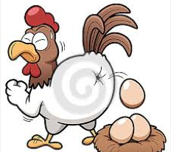
Ex 2. Number of eggs laid by a hen; one discrete/whole egg at a time.
Hen laying an egg

Slide 6
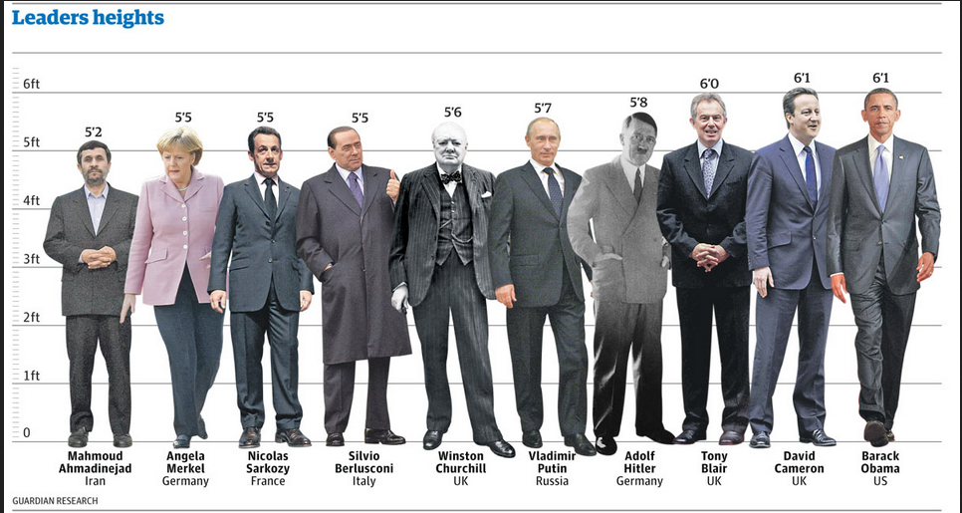
Continuous Data:
Data that can take on any numeric value, with
decimal places.
Ex 1. Height

Slide 7
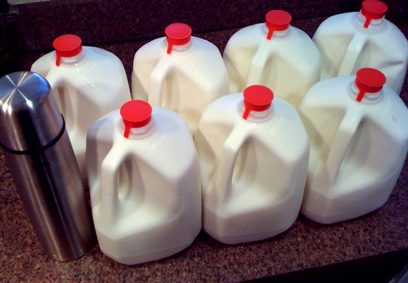
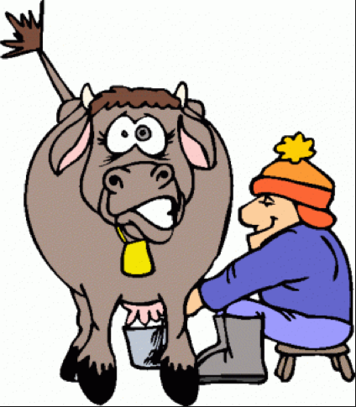
Ex 2. Milk production in cows
- avg about 6 to 7 gallons a day
- bad days make 6.001 gallons;
- on good days make 7.262 gallons

Slide 8
Types of Qualitative Data
2 types
Nominal Data
- organized into categories or groups
- cannot be organized into ordering systems
Ex 1. “Yes”, “No” or “Undecided” Answers
Ex 2. Colors of cars (Black, Silver, White, etc…)
Ex 3. Religious affiliation
(Christians, Catholics, Agnostics, Buddhists, Muslims)

Slide 9
2. Ordered/Ordinal Data
- Organized into order groups or
categories.
Ex 1. Education Level
- Elementary School
- High School
- College
- Graduate School
Education level can be ranked from basic to advanced

Slide 10
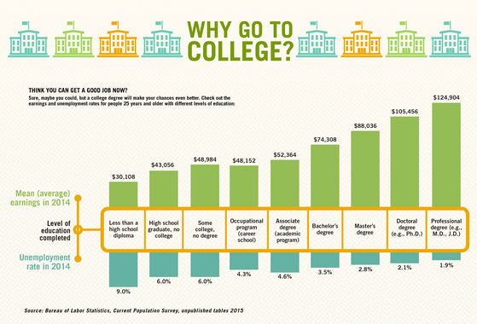
How much will you make?

Slide 11
Ordinal Data Continued…
Ex 2. Class Letter Grades
A, B, C, D, & F
A letter “B” is higher than “C”, but you can’t subtract “C” from “B”

Slide 12
Other types of Data
Intervals
- Data is between two meaningful number
values
- Does not have a “natural zero” starting
point
Ex 1. Body Temperatures ranges b/w 98.2ºF and
98.6ºF
Ex 2. Years (1995, 2015, 1886, and 1919)
Time does not start with Year 0

Slide 13
Other types of Data
Ratios
Similar to intervals, with meaningful data values, BUT has a natural zero starting point

Slide 14
Ex. Distance Traveled
Jane lives 2 miles away from school
Sharon lives 4 miles away from school
Jane
Sharon
2 mi
0 miles
0 miles
4 mi

Slide 15
Data Types Scavenger Hunt
GOAL: Determine which Sample data represent Discrete, Continuous, Nominal, or Ordinal data. 1) Work in Pairs of 2
Go to the different lab stations and examine the different data. Determine what type of Data it is (Qualitative or Quantitative)
If Qualitative, is it NOMINAL or ORDINAL
If Quantitative, is it DISCRETE or CONTINUOUS
2) Start with the Sample Data # at the Lab Station you are at, when done, move to another table to complete your set of data. Make sure you follow your own Data Sample # sets. 3. Read the Sample Data, determine if it's Discrete, Continuous, Nominal, or Ordinal. Some will have 2 answers (HINT: Graphical Data). Put a "Check" in the box that best categorizes the Sample Data. 4. Write a brief explanation to justify what about the Sample Data made you check the type of data.

