Slide 1
Notes #3
Ch 1-3: Critical Thinking
Using Common Sense to Analyze Data

Slide 2
2 Ways to Look at Data
A parameter
Numerical measurement describing some trait of an entire population
Ex. Total population of the City of Alhambra is 83,089, where 47.3% of the population are men.
U.S. Census 2010 Data

Slide 3
2. A statistic
Numerical measurement describing some trait of a sample group.
Ex. Based on a sample of 41 students in Ms. Ng’s Stats class, it was found that 12% of them selected Math as their favorite subject.

Slide 4
How do you improve skills in interpreting data?
Use common sense
Think carefully about the context, source, method, conclusions and practical implications.

Slide 5
How Stats is Misused?
1. Evil intent on the part of dishonest people. “It’s all lies!”
2. Mistakes on the part of people who don’t know any better.

Slide 6
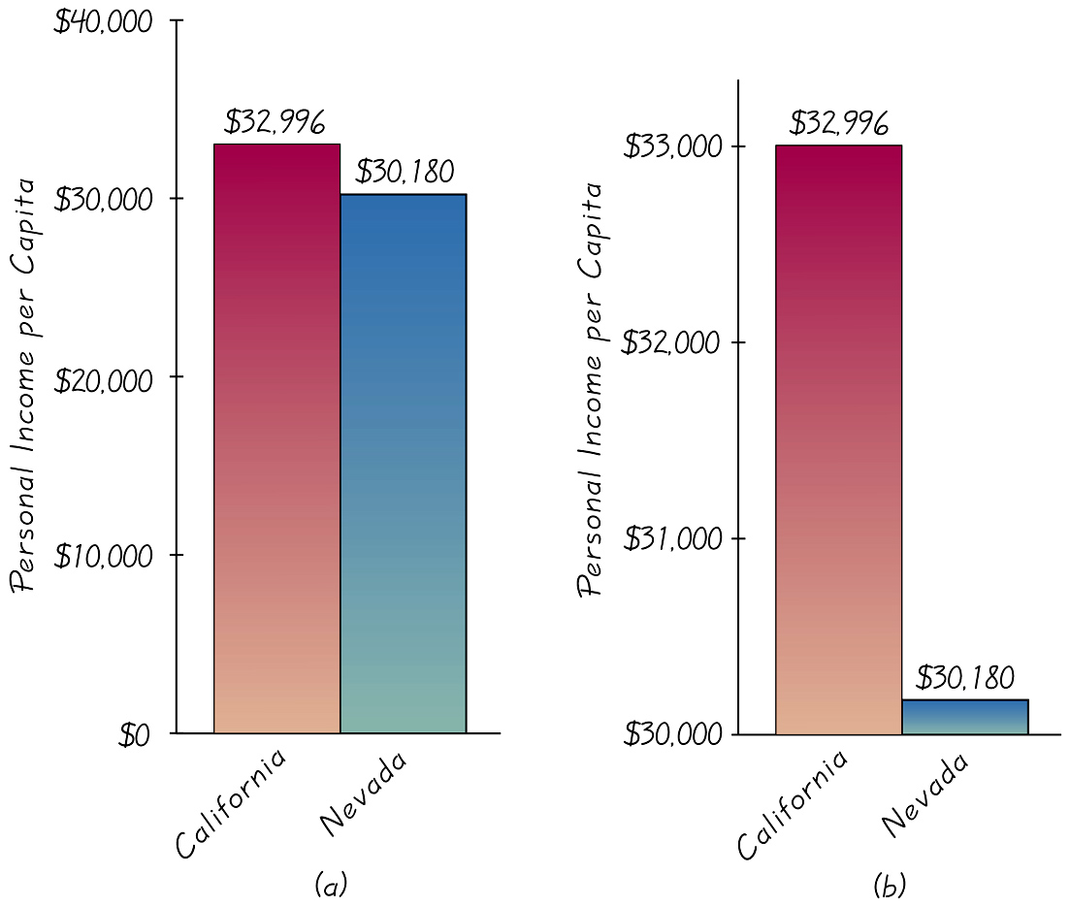
Examples of Misleading Graphs and Data
(A)
(B)
Q: What’s wrong with this graph?
ANS: Personal income from Graph (A) and (B) is the same.
CA: $32, 996
Nev: $30,180
BUT the bars are misleading in Graph (B).
Graph (B) bars show CA income is “a lot” higher than Nev’s income (misleading)

Slide 7
How to avoid being misled by graphs?
Analyze the numerical information given in the graph
Do not rely only on the graph’s shape.
READ labels and units on the axes

Slide 8
Percentages
Misleading or unclear percentages are sometimes used.
Ex. 100% of the teachers surveyed have a dog as a pet, therefore dogs are the preferred pet for teachers.
Truth (behind the survey): Only 5 teachers were surveyed, so 5 of 5 teachers, give you 100%.
Problem? Survey not fairly representing the faculty, making the data misleading.

Slide 9
How to find the truth behind data with Percentages?
Find out the actual number of individuals surveyed from the sample or population.
Conclusions should not be based on samples that are far too small (i.e. 5 teachers surveyed)
Top 10 False Advertisements that got caught

Slide 10
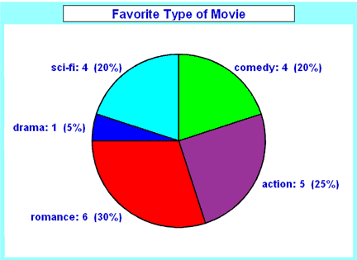
Representing Percentages w/ Pie Charts
What are pie charts?
ANS: a special chart that uses "pie slices" to show relative sizes of data (usually in percentage).
Ex.

Slide 11
4 Steps to Create a Pie Chart
Put your data into a data table, with a categorical group & Number count/frequency. Then add up the total.
Ex.
Movie Types | Frequency
Comedy | 4
Action | 5
Romance | 6
Drama | 1
SciFi | 4
Total | 20

Slide 12
2. Determine the percentage for each group type, and insert a column to the data table.
Movie Types | Frequency | Percentage breakdown
Comedy | 4 | 20%
Action | 5 | 25%
Romance | 6 | 30%
Drama | 1 | 5%
SciFi | 4 | 20%
Total | 20 | 100%

Slide 13
3. Determine how many degrees are for each "pie slice”
Equation (Calculate Degrees of the Sector “pie slice”
[Number count ÷ Total]× 360°= Degree of Sector
Movie Types | Frequency | Percentage breakdown | Degree of Sector
Comedy | 4 | 20%
Action | 5 | 25%
Romance | 6 | 30%
Drama | 1 | 5%
SciFi | 4 | 20%
Total | 20 | 100% | 360º
Notes:
72º; 90º; 108º; 18º, & 72º

Slide 14
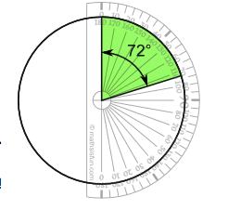
4. Draw a circle, then use a protractor to mark the degrees of each sector.
Ex. Comedy makes of 20% of the pie chart, with a sector at 72º
How to make a pie chart?

Slide 15
Notes #4
Ch 1-3: Working with Percentages

Slide 16
What % really means?
ANS: It means “divided by 100”
Ex. When asked to find the percent of something you:
1. Drop the % symbol
2. Divide the percentage value by 100.
3. Multiply to target population or sample #

Slide 17
Sample Problem 1:
3% of MKHS’s 2408 ASB population are mixed races. What is the total number count of these students?
[3 ÷ 100] x 2408 =
[0.03] x 2408 = 72.24
ANS: In MKHS’s ASB population of 2408 students, there are approximately 72 students who are mixed races.

Slide 18
Converting Fraction to %
When you convert from a fraction to a % you:
1. Divide denominator into the numerator to get a decimal #
2. Multiply decimal # by 100%
Sample Problem #2
What is the in percent?
a. 3 ÷ 20 = 0 .15
0 .15 x 100% = 15%

Slide 19
Decimal to %
When converting a decimal to a percentage you:
Multiply decimal to 100%
Sample Problem #3
Convert 0.786 to a percent
0.786 x 100% = 78.6%

Slide 20
Percentage to Decimal
To convert percentage to decimal you:
Delete % symbol
Divide by 100
Sample Problem #4
What is 37% in decimal?

