Slide 1
Evidence of Evolution
Notes #7

Slide 2
(4 Types of Evidence)
1. The Fossil Record: Remains of ancient life form that shows Earth’s history.
a. How do fossils form?
Remains of the dead organism is buried and preserved under sedimentary rocks for long periods of time.

Slide 3
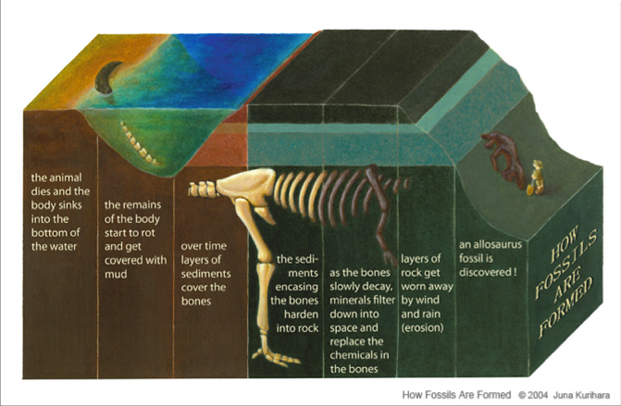
How Fossils Form

Slide 5
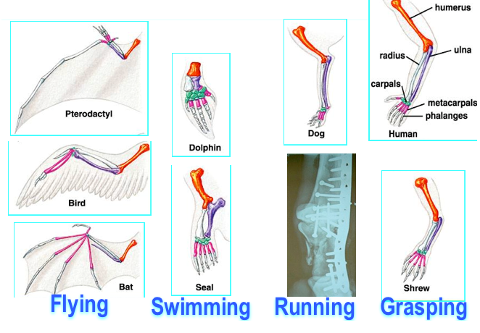
2. Homologous Body Structure: Body parts that have similar bone structure, but different mature functions.

Slide 6
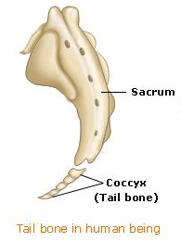
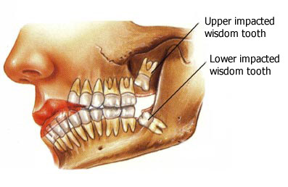
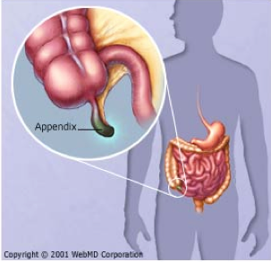
a. What are vestigial organs?
ANS: Structures that no longer have important functions in modern organisms.
Ex. Human Tail Bone, Wisdom Teeth, & Appendix

Slide 7
3. Evidence from Embryology
What is Embryology?
ANS: The study of the development of an embryo from fertilization of the egg to the fetus stage.

Slide 8
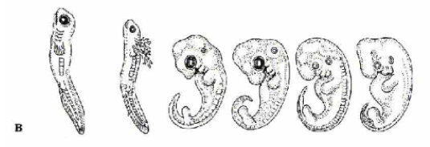
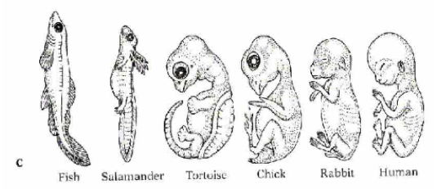
Comparative Embryology

Slide 9
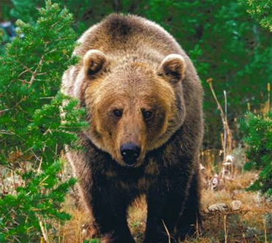
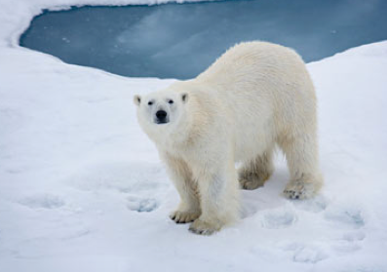
4. Geographic Distribution of Living Species
How is geographic distribution evidence for evolution?
ANS: It shows a common ancestry with similar animals found in different parts of the world.
Ex. Brown Bear found in North America
Polar Bear found in the North Pole

Slide 10
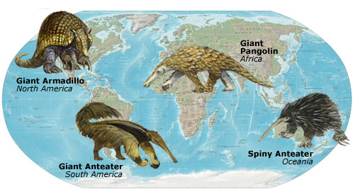
Geographic Distribution of Species

Slide 11
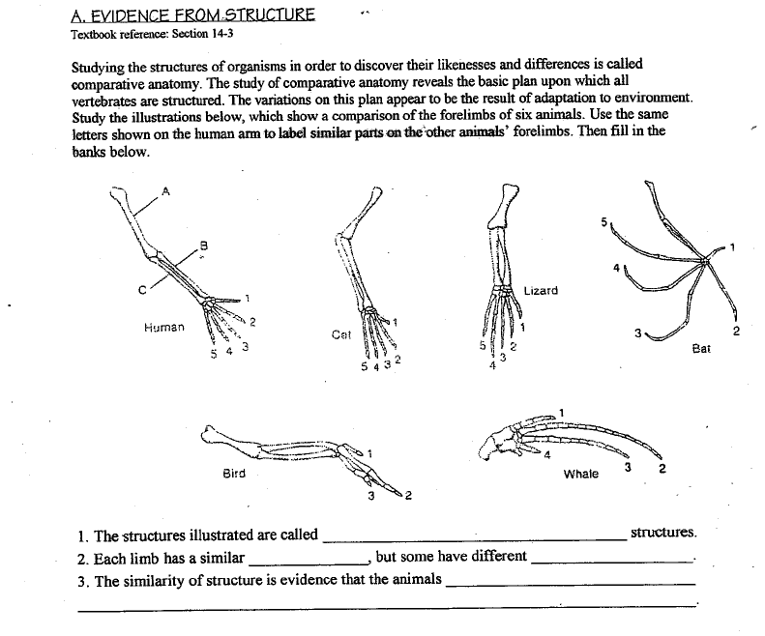
CW
homologous/forelimbs
structure
functions
come from a common ancestor

Slide 12
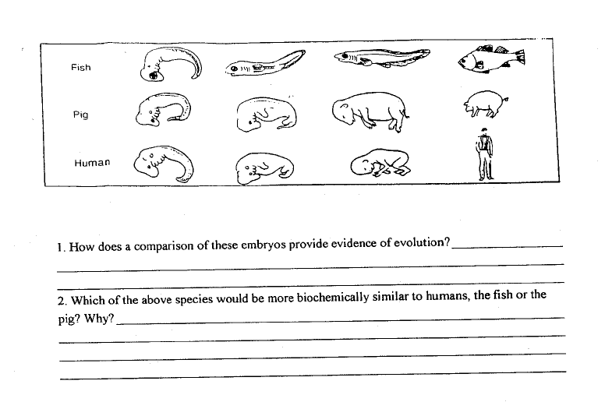
Every living thing shares similar early developmental features, which relates us to a common ancestor
The pig, because humans and pigs are mammals and share similar physical features (warm-blooded, provide milk to babies, etc)

Slide 13
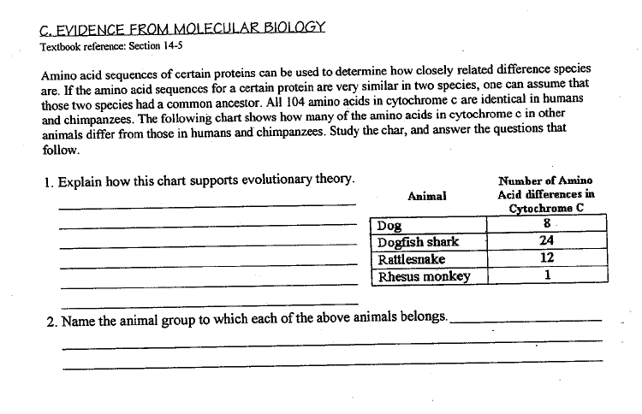
The chart gives the # of amino acids different from humans, the higher the # the more distantly related, the lower the #, the more closely they are to humans
Rhesus Monkey (Mammals); Rattlesnake (reptiles); Dogfish Shark (Fish); Dog (mammals)

