Slide 1
Human Population Growth
Notes #1

Slide 2
How many are Humans on Earth?
ANS: Today, the world’s human population contains 7.6 billion people (May 2018), and is growing slowly.

Slide 3
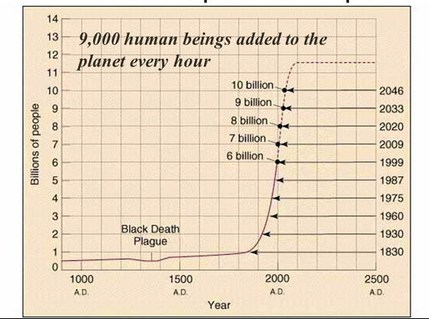
Predicted Human Population Growth

Slide 4
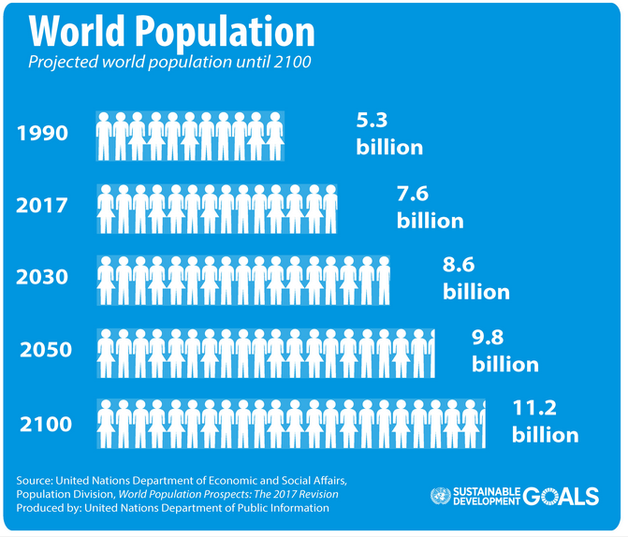
Growth of Human Population (1990-2100)

Slide 5
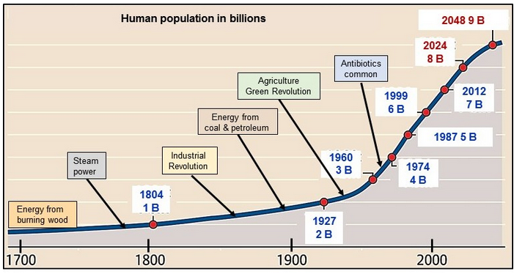
Main Causes for Human Population Exponential Growth
3 Main Causes
Industrial Revolution
Increased coal burning
(1800 – 1920s)
2) Agriculture Green Revolution
(1950s – 1960s)
3) Major Medical & Technological
Advances (1980s - Present)

Slide 6
Stage 1: Industrial Revolution Influence on the Exponential Growth of the Human Population
Stage 1

Slide 7
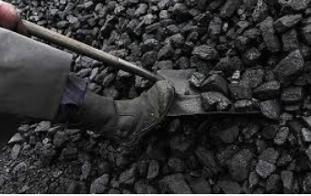
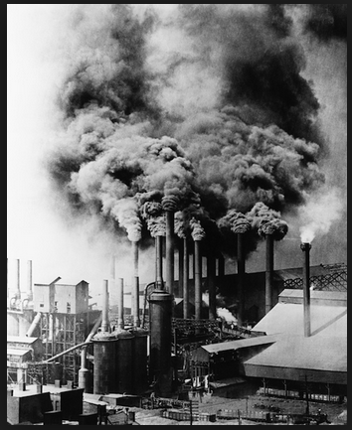
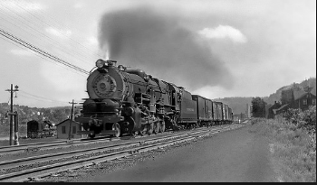
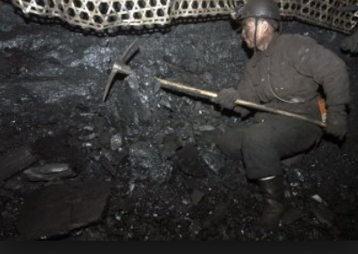
Industrial Revolution
What Happened During the Industrial Revolution?
ANS: Mass production & transportation of goods using machines, increased use of coal mining/burning.

Slide 8
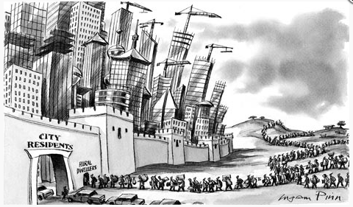
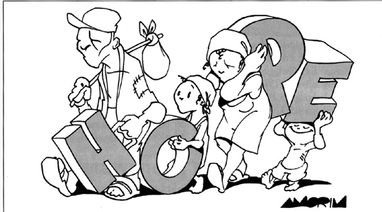
What 2 Impact did the Industrial Revolution have on Human Population?
1) Increased job security and young people moving into the cities to find work.

Slide 9
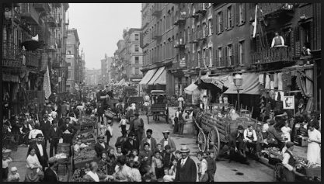
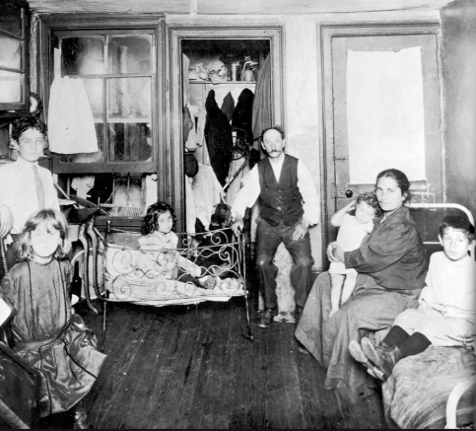
2) Increased urbanization & food availability, people ended up with more resources and opportunities to find a partner & start a family.

Slide 10
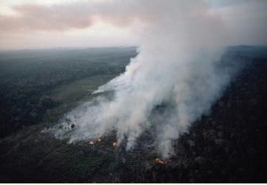
Making Room for Factories
People clear cut and burned HALF of the world’s original forests that led to the loss of biodiversity & increase rate of climate change.

Slide 11
Stage 2: Green Revolution Influence on the Exponential Growth of the Human Population
Stage 2

Slide 12
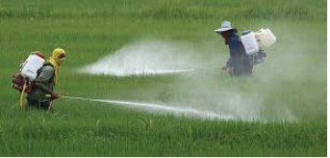
What was the Green Revolution (1950s-1960s)?
ANS: The use of chemical fertilizers and pesticides to grow more crops to feed a growing human population.

Slide 13
What Impact did The Green Revolution have on the Human Population?
ANS: Green Revolution caused the Human Population to increase from 2 Billion People (1927) to 3 Billion (1960) in just 33 years.
Stage 2

Slide 14
Stage 3: Advances in Medicine & Technology Impact on the Exponential Growth of the Human Population
Stage 3

Slide 15
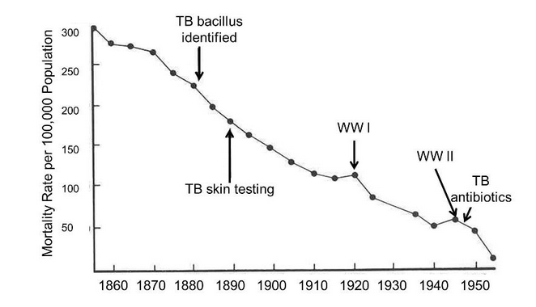
How did Major Medical Advances & Technology Impact the Human Population? (1970s- Present)
(3 Major Impacts)
More lives were saved due to use of antibiotics to fight bacterial infections (reduced death rates)
Ex. TB Testing and TB Antibiotic to reduce TB Infections

Slide 16
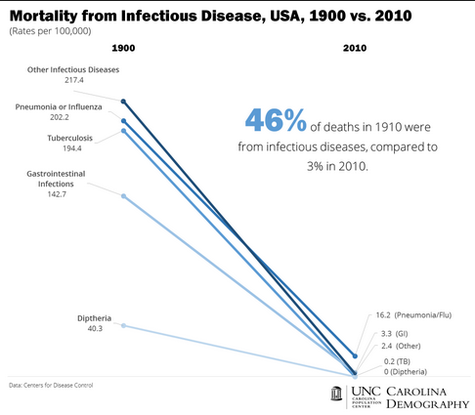

Slide 17
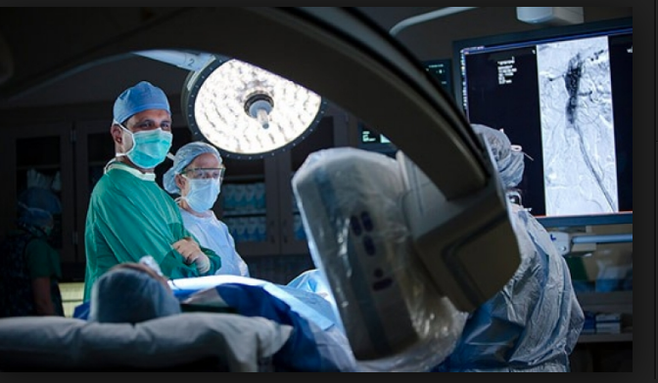
2) People receiving advanced medical treatment and preventative health care

Slide 18
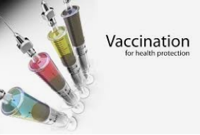
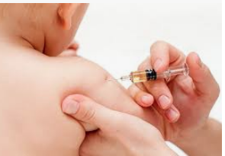
3) Wide use of vaccinations to eliminate deadly childhood diseases.

Slide 19
Measles Vaccination Introduced in 1963
&
MMR combo Vaccination (1971)
Measles Death (before 1963 Vaccination):
Avg of 550 deaths a year
Measles Death (with Vaccinations in 2008):
0.33 deaths a year

Slide 20
Chicken Pox Vaccine (Introduced in 1995)

Slide 21
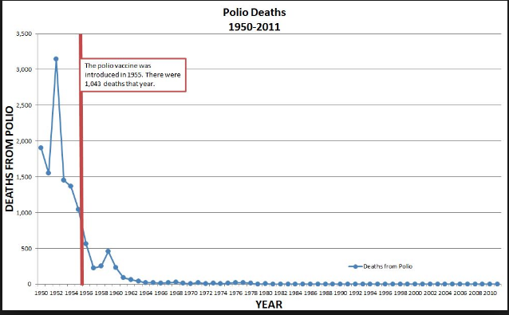
Polio Vaccine (Vaccine Introduced 1955)

Slide 22
CONCLUSION: Advances in Medicine & Technology Decreased Death Rates and Improved People’s Health so they can live longer, leading to a population boom.
Stage 3

