Slide 1
Notes #12: Creating Histograms
Ch 2-3

Slide 2
What is a Histogram?
ANS: A graph of bars with equal width drawn adjacent to each other (unless there are gaps in the data)
x-axis represents the classes of quantitative data values
y-axis represents the frequencies.
The heights of the bars correspond to the frequency values.

Slide 3
What is the purpose of Histograms?
ANS: To visualize & analyze the shape of the distribution of the data.

Slide 4
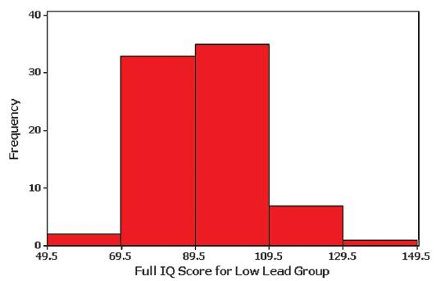
Example
IQ scores from children with low levels of lead exposure.
IQ Score | Frequency
50-69 | 2
70-89 | 33
90-109 | 35
110-129 | 7
130-149 | 1

Slide 5
How to Construct a Histogram
1. Identify the Group Boundaries
IQ Score | Frequency
50-69 | 2
70-89 | 33
90-109 | 35
110-129 | 7
130-149 | 1
(a)
(b)
(c)
(d)
(e)
(f)
Class Boundaries
(a)
(f)
(b)
(c)
(d)
(e)

Slide 6
How to Construct a Histogram
2. Mark each Group Boundary on the Graph.
3. Draw your Bars (WITHOUT spaces between them) with the given frequencies.

Slide 7
Relative Frequency Distribution
includes the same class limits as a frequency distribution, but the frequency of a class is replaced with a relative frequencies (a proportion) or a percentage frequency ( a percent)
Formula:
Relative
frequency
Group frequency
=
× 100%
sum of all frequencies

Slide 8
Ex. Relative Frequency Distribution
IQ Score | Frequency | Relative Frequency
50-69 | 2
70-89 | 33
90-109 | 35
110-129 | 7
130-149 | 1

Slide 9
Ex. Relative Frequency Distribution
IQ Score | Frequency | Relative Frequency
50-69 | 2 | 2.6%
70-89 | 33 | 42.3%
90-109 | 35 | 44.9%
110-129 | 7 | 9.0%
130-149 | 1 | 1.3%

Slide 10
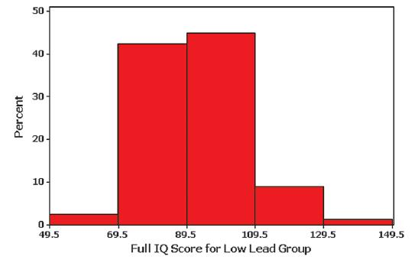
Traits of a Relative Frequency Histogram
Has the same shape and x-axis as a histogram
The y-axis is marked with relative frequencies instead of actual frequencies
IQ Score | Relative Frequency
50-69 | 2.6%
70-89 | 42.3%
90-109 | 44.9%
110-129 | 9.0%
130-149 | 1.3%

Slide 11
Interpreting Histograms
Purpose is to understand something about the data in the histogram
When graphed, a normal distribution has a “bell” shape. Characteristic of the bell shape are
(1) The frequencies increase to a maximum, and then decrease.
(2) symmetry, with the left half of the graph roughly a mirror image of the right half.

Slide 12
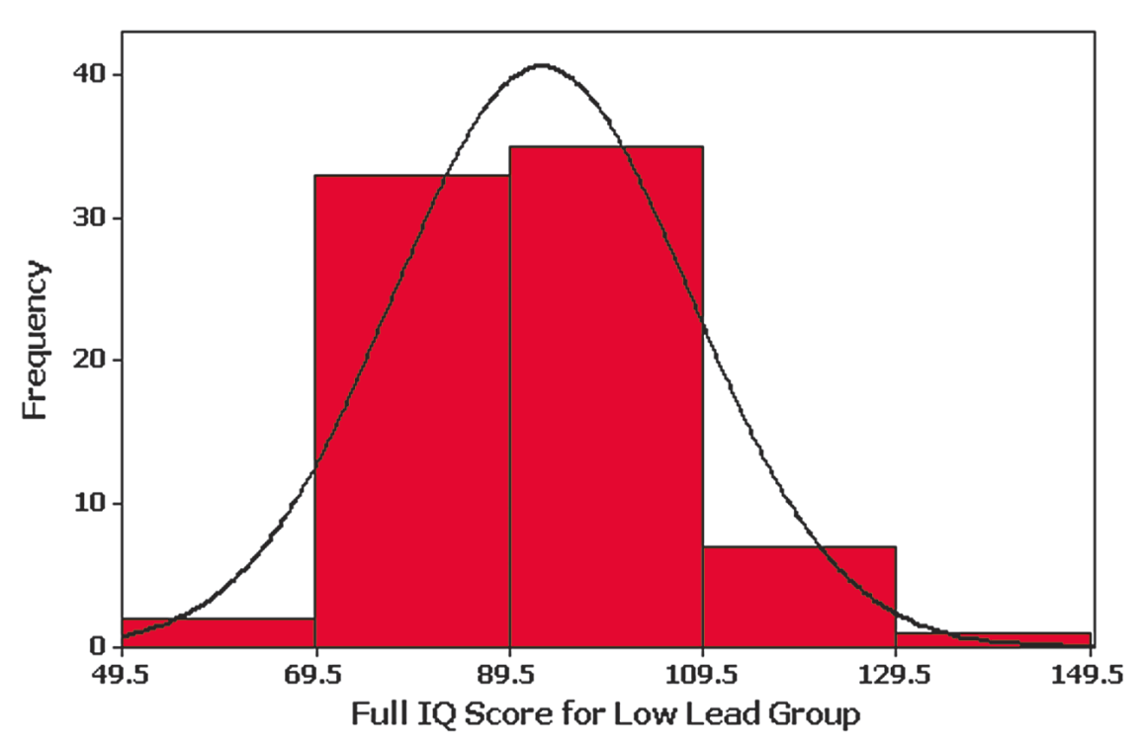
Example – IQ Scores
Things to ask…
1. What is the shape
of this distribution?
2. What is the
median/center?
3. Are there any
outliers (data that
sticks out or far
away from the rest of
the data)?

Slide 13
Skewdness Review
A distribution of data is skewed if it is not symmetric and extends more to one side to the other.
Data skewed to the right (positively skewed) have a longer right tail.
Data skewed to the left (negative skewed) have a longer left tail.

Slide 14
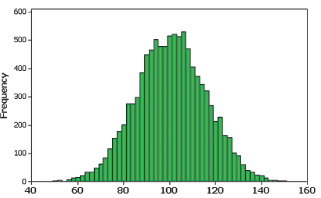
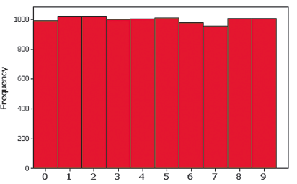
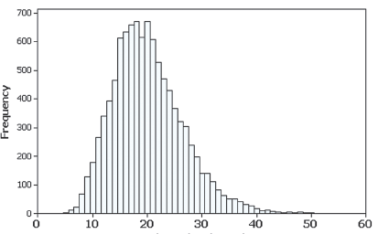
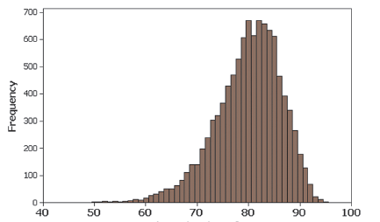
Example – Discuss the Shape

Slide 15
Cumulative Frequency Distribution
The cumulative frequency is calculated by adding each frequency to the sum of
the previous cumulative frequency value.
The last value will always be equal to the total for all observations, since
all frequencies will already have been added to the previous total.
IQ Score | Frequency | Cumulative Frequency
50-69 | 2 | 2
70-89 | 33 | 35
90-109 | 35 | 70
110-129 | 7 | 77
130-149 | 1 | 78
Cumulative Frequencies

