Slide 1
Notes #13
3 Set Venn Diagrams

Slide 2
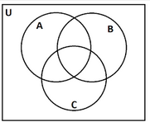
Organizing a 3 set Venn Diagram

Slide 3
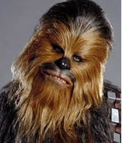
Example #1
A survey of STAR WARS fans revealed the following information:
51 admire Yoda
49 admire Darth Vader
60 admire Chewbacca “Chewy”

Slide 4
34 admire Yoda and Darth Vader
32 admire Vader and Chewbacca
36 admire Yoda and Chewbacca
24 admire all three STAR WARS Icons
1 admires none of the STAR WAR Icons

Slide 5
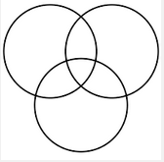
SOLUTION (10 Steps)
Step 1: Draw & Create a Key for the Venn Diagram
KEY
Y: Yoda
DV: Darth Vader
C: Chewy
(Y):51
(DV):49
(C):60

Slide 6
Step 2: Start with Y DV C
“24 admire all three STAR WARS Icons”
51
49
24
60

Slide 7
Step 3: (Y DV C)’:
“1 admires none of the STAR WARS Icons”
Y
DV
24
1
C

Slide 8
Step 4:
“36 admire Yoda & Chewy
Y
DV
36 - 24 = 12
24
12
36
1
C

Slide 9
Step 5:
“32 admire DV & Chewy”
Y
DV
24
12
8
32
32 - 24 = 8
1
C

Slide 10
Step 6:
“34 admire Y & DV”
Y
DV
34
10
24
12
8
34 - 24 = 10
1
C

Slide 11
Step 7:
Fans who only admire Chewy
51
49
10
24
12
8
60-12-24-8 = 16
16
1
60

Slide 12
Step 8:
Fans who ONLY admire Darth Vader
51
49
7
= 49-10-24-8
10
7
24
12
8
16
60
1

Slide 13
Step 9:
Fans who ONLY admire Yoda
51
49
51-10-24-12=
5
5
10
7
24
12
8
16
60
1

Slide 14
Step 10:
Use the Completed Venn Diagram to answer
the given questions
51
49
5
10
7
24
12
8
16
60
1

Slide 15
Q1:
How many people were surveyed?
Total People surveyed
= 5 + 10 + 7+ 8 +16 +12 + 24 + 1
= 83 ppl were surveyed.
51
49
5
10
7
24
12
8
16
60
1

Slide 16
Q2:
How many admire Chewy, but not Yoda nor Darth Vader?
ANS: 16 ppl admire Chewy, but not Yoda nor Darth Vader.
51
49
5
10
7
24
12
8
16
60
1

Slide 17
Q3:
How many admire Darth Vader or Chewy?
Or “admire Darth Vader, or admire Chewy, or admire both?”
10 + 7 + 8 + 16 + 12 + 24 = 77
51
49
5
10
7
24
12
8
16
60
1
ANS: 77 ppl admire Darth Vader or Chewy.

Slide 18
Q4:
How many admire exactly one of the Star Wars Icon?
HINT: 3 Possibilities
5 + 7 + 16 = 28
51
49
5
10
7
24
12
8
16
60
1
ANS: 28 ppl admire exactly one of the Star Wars Icon.

Slide 19
Q5:
How many admire exactly 2 of the Star Wars Icons?
10 + 8 +12 = 30
51
49
5
10
7
24
12
8
16
60
1
ANS: 30 people admire exactly two of the Star Wars Icons.

Slide 20
Classwork #1
A group of 82 students were surveyed. The survey says that all students liked eating at least one or more of the following fruits (apricot, banana, and cantaloupes)
39 liked apricots. 50 liked bananas. 39 liked cantaloupes.
21 liked apricots and bananas. 18 liked bananas and cantaloupes. 19 liked apricots and cantaloupes. 22 liked exactly two of the following fruits: apricots, bananas, and cantaloupes

Slide 21
KEY
A: Apricot
B: Banana
C: Cantaloupe
(A): 39
(B): 50
21
STEP #1:
21 liked apricots and bananas.
18 liked bananas and cantaloupes.
19 liked apricots and cantaloupes.
19
18
(C): 39

Slide 22
KEY
A: Apricot
B: Banana
C: Cantaloupe
n(A): 39
n(B): 50
21
21 - X
STEP 2
Let X: A B C
X
19 - X
18 - X
19
18
STEP 3
Set up equations to solve for
Missing info.
N(C): 39

Slide 23
KEY
A: Apricot
B: Banana
C: Cantaloupe
n(A): 39
n(B): 50
:“22 liked exactly two of the following fruits:
apricots, bananas, and
Cantaloupes”
21 - X
X
19 - X
18 - X
Step 4: Solve for X
22=
21 - X
+
18 - X
+
19 - X
22 =21+18+19-3x
N(C): 39
3x = 21+18+19-22
x = 36/3 = 12

Slide 24
KEY
A: Apricot
B: Banana
C: Cantaloupe
n(A): 39
n(B): 50
21 – 12=
12
Step 5
Solve for the missing data
19 – 12=
18 – 12=
N(C): 39

Slide 25
KEY
A: Apricot
B: Banana
C: Cantaloupe
n(A): 39
n(B): 50
11
23
9
12
7
6
14
N(C): 39

Slide 26
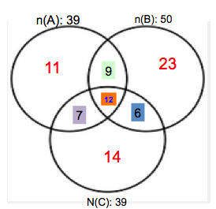
a. How many students liked apricots, but not bananas or cantaloupes?
KEY
A: Apricot
B: Banana
C: Cantaloupe
ANS: 11 students liked
apricots, but not
bananas or
cantaloupes.

Slide 27
b. How many students liked cantaloupes, but not bananas or apricots?
ANS: 14 students liked
cantaloupes, but not
bananas or apricots.
.

Slide 28
c. How many students liked all of the following three fruits: apricots, bananas, and cantaloupes?
ANS: 12 students all 3
fruits.

Slide 29
d. How many students liked apricots and cantaloupes, but not bananas?
ANS: 7 students liked
apricots &
cantaloupes, but
not bananas.

Slide 30
Just for Fun….
At a restaurant, Harry, Ron, Hermonie, Snape, and Albus were asked if they had ordered (not eaten ☺) any of the following: chicken marsala, lasagna, or coke.
3 people ordered chicken marsala (Hermonie, Albus, Ron).
2 people ordered lasagna (Snape and Albus).
3 people ordered coke (Harry, Ron, and Snape).
1 person ordered both chicken marsala and lasagna (Albus).

Slide 31
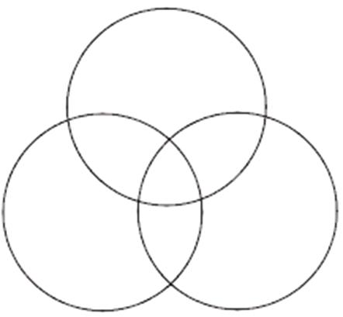
Harry (coke)
Hermonie (chicken marsala)
chicken marsala
Ron (chicken marsala, coke)
Snape (lasagna, coke)
Hermonie
Albus
Ron
Albus (chicken marsala, lasagna)
Snape
Harry
lasagna
coke

