Slide 1
Notes #13
Ch 2-4: Frequency Polygon & Cumulative Frequency

Slide 2
What graph to use to display Class Midpoints
ANS: Frequency Polygon
What is a Frequency Polygon?
ANS: A line graph is drawn by joining all the midpoints of the top of the bars of a histogram.

Slide 3
Complete the Mid Points for each Class
Marks | Frequency | Mid Point
0-4 | 0
5-9 | 4
10-14 | 10
15-19 | 20
20-24 | 13
25-29 | 8
30-34 | 0

Slide 4
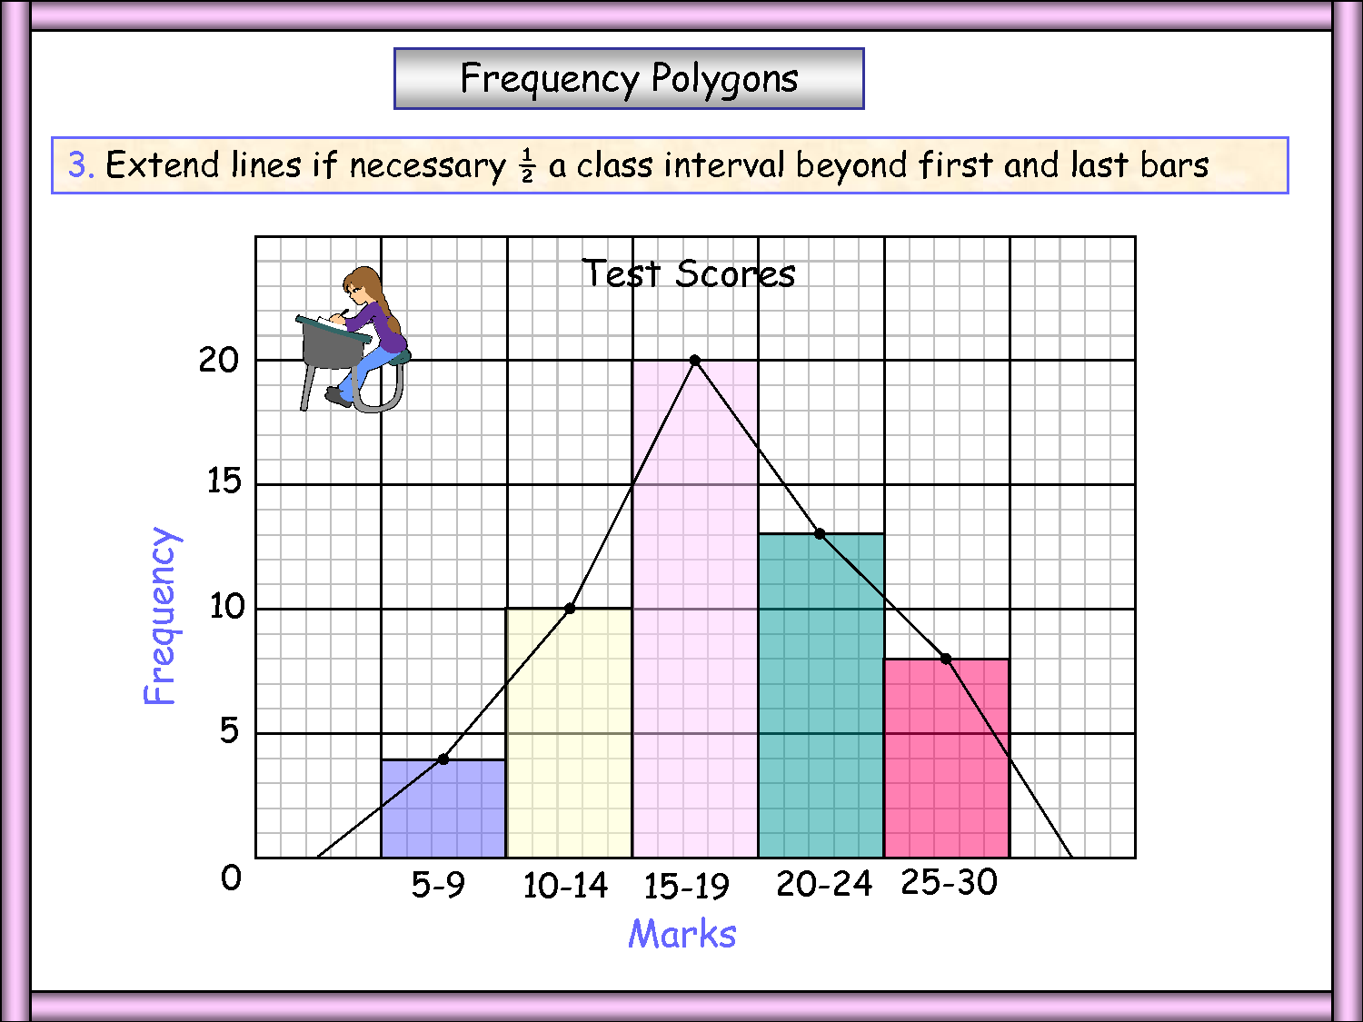
Steps to Creating a Frequency Polygon
Graph the histogram
Mark the midpoint of each class on the top of the bar.
Connect the Midpoints with a line.
Extend the line 0.5 class interval beyond the first and last bar.
3
2
4
1

Slide 5
Ex 1. Frequency Polygon & Histogram
Marks | Freq | Midpt
0-4 | 0 | 2
5-9 | 4 | 7
10-14 | 10 | 12
15-19 | 20 | 17
20-24 | 13 | 22
25-29 | 8 | 27
30-34 | 0 | 32

Slide 6
Purpose of Frequency Polygons
ANS: Gives the idea about the shape of the data distribution.

Slide 7
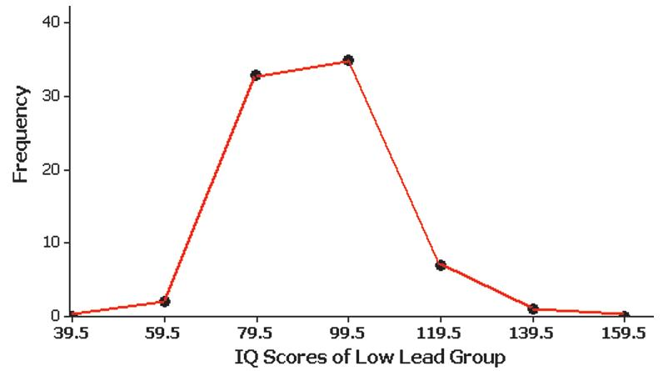
Ex 2. Frequency Polygon w/o a Histogram
IQ Score | Midpoint | Freq
30-49 | 39.5 | 0
50-69 | 59.5 | 2
70-89 | 79.5 | 33
90-109 | 99.5 | 35
110-129 | 119.5 | 7
130-149 | 139.5 | 1
150-169 | 159.5 | 0

Slide 8
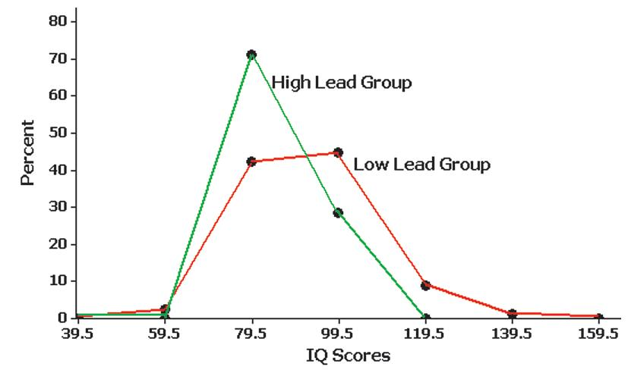
Relative Frequency Polygon
Uses relative frequencies (proportions or percentages) for the vertical scale.
Ex.
Low Lead Group IQ Score
IQ Score | Midpt | Rel Freq
30-49 | 39.5 | 0
50-69 | 59.5 | 2.6%
70-89 | 79.5 | 42.3%
90-109 | 99.5 | 44.9%
110-129 | 119.5 | 9.0%
130-149 | 139.5 | 1.3%
150-169 | 159.5 | 0

Slide 9
Cumulative Frequency Distribution
What is it?
ANS: Is used to determine the number of observations that
lie above (or below) a particular value in a data set.

Slide 10
Calculating Cumulative Frequency
ANS: Add each frequency to the sum
of the previous cumulative frequency value.
The last value of the Cumulative Frequency will always
be equal to the total frequency count (i.e. 78)
(N= 2 + 33 + 35 + 7 + 1= 78).
IQ Score | Frequency | Cumulative Frequency
50-69 | 2 | 2
70-89 | 33 | 35
90-109 | 35 | 70
110-129 | 7 | 77
130-149 | 1 | 78
Cumulative Frequencies

Slide 11
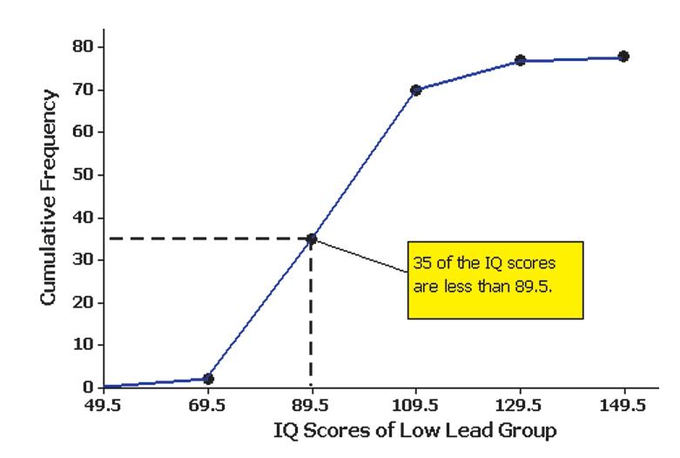
Ogive
A line graph that depicts cumulative frequencies
IQ Score | Upper Class Boundaries (x) | Cumulative Frequency (y)
30-49 | 49.5 | 0
50-69 | 69.5 | 2
70-89 | 89.5 | 35
90-109 | 109.5 | 70
110-129 | 129.5 | 77
130-149 | 149.5 | 78

