Slide 1
Cumulative Frequency & Ogive Graphs
Notes #13a

Slide 2
Recap on Cumulative Frequency
ANS: running total of the frequencies from the previous
class to the next.
Ex. Fill-in the Cumulative Frequency
IQ Score | Frequency | Cumulative Frequency
50-69 | 2
70-89 | 33
90-109 | 35
110-129 | 7
130-149 | 1

Slide 3
Recap on Cumulative Frequency
ANS: running total of the frequencies from the previous
class to the next.
IQ Score | Frequency | Cumulative Frequency
50-69 | 2 | 2
70-89 | 33 | 35
90-109 | 35 | 70
110-129 | 7 | 77
130-149 | 1 | 78

Slide 4
How to Graphically Display Cumulative Frequency Data
ANS: Use an Ogive (‘o-jive’) Graph; A line graph that depicts cumulative frequencies
(a.k.a: Cumulative Frequency Polygon)

Slide 5
How to Draw an Ogive
ANS: Plotting the Upper Class Boundaries on the x-axis and Cumulative Frequency on the y-axis
IQ Score | Upper Class Boundaries (x) | Cumulative Frequency (y)
30-49 | 49.5 | 0
50-69 | 69.5 | 2
70-89 | 89.5 | 35
90-109 | 109.5 | 70
110-129 | 129.5 | 77
130-149 | 149.5 | 78

Slide 6
3 Steps to Creating an Ogive
Modify the original Frequency Distribution by adding NEW starting Group. (See the “Before” & “After” sample)
- Fill in the Upper Boundaries for each Group/Class

Slide 7
Fill in the Upper Boundaries for each CLASS
Provided Frequency Distribution
(BEFORE)
“Modified” Frequency Distribution
(AFTER)
IQ Score | Upper Boundaries (x) | Cumulative Frequency (y)
50-69 |  | 2
70-89 |  | 35
90-109 |  | 70
110-129 |  | 77
130-149 |  | 78
IQ Score | Upper Boundaries (x) | Cumulative Frequency (y)
30-49 | 49.5 | 0
50-69 |  | 2
70-89 |  | 35
90-109 |  | 70
110-129 |  | 77
130-149 |  | 78

Slide 8
2. Plot the Upper Boundaries on the x-axis & the Cumulative Frequency on the y-axis
Ex. X-axis labeled “IQ Scores of Lower Lead Group”
y-axis “Cumulative Frequency”

Slide 9
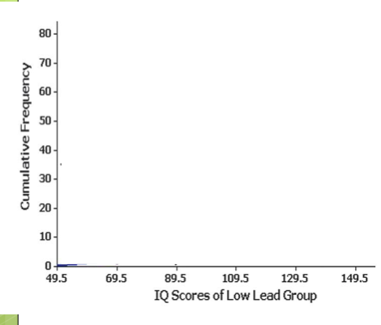

Slide 10
3. Plot the data points and connect the points

Slide 11
Purpose of an Ogive/Cumulative Frequency Polygon
ANS: Used to visually represent how many values are below a certain Upper Class Boundary.

Slide 12
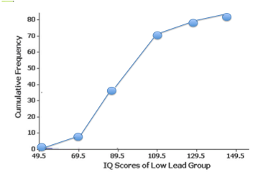
Ex. How many individuals have an IQ Score less than 89.5?
1. Draw a vertical line up from 89.5 till it intersects with the graph.

Slide 13
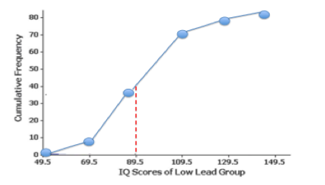
2. From the point of intersection, draw a horizontal line to the
y-axis; where the line meets the number, is your answer.
How many individuals have an IQ Score less than 89.5?
ANS: 40 out of 78 individuals tested have an IQ Score less than 89.5.

Slide 14
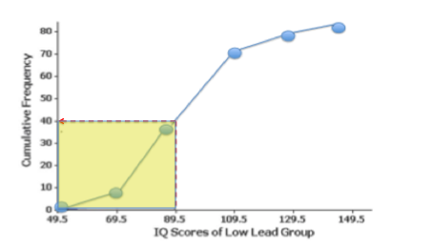
Example 2. How many people have an IQ score HIGHER than 89.5
Indicate the Total # of people tested
ANS (A): 78
Indicate the Total # of people with IQ Score less than 89.5.
ANS (B): 40
3. Subtract ANS (B) from ANS (A)
78 - 40 = 38
FINAL ANS: There are 38 people with an IQ score HIGHER than 89.5.

