Slide 1
Notes #14: Stem Plots

Slide 2
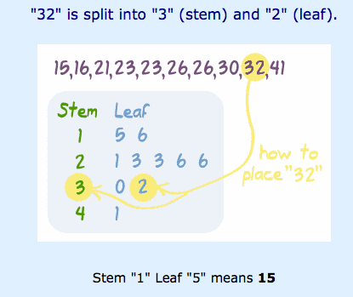
What is a Stem Plot?
ANS: A Stem and Leaf Plot is a special table where each data value is split into a "stem" (the first digit or digits) and a "leaf" (usually the last digit).
Example:

Slide 3
Stem vs Leaf
The "stem" values are listed down, and the "leaf" values go right (or left) from the stem values.
The "stem" is used to group the scores and each "leaf" shows the individual scores within each group.
Ex. Sam got his friends to do a long jump and got these results:
2.3, 2.5, 2.5, 2.7, 2.8 3.2, 3.6, 3.6, 4.5, 5.0
The stem-and-leaf plot:
Stem Leaf
2 3 5 5 7 8
3 2 6 6
4 5
5 0

Slide 4
How to interpret a Stem Plot?
Data Set: 2.3, 2.5, 2.5, 2.7, 2.8 3.2, 3.6, 3.6, 4.5, 5.0
Stem | Leaf
2
3
4
5
4 STEPS
1) Say what the stem and leaf mean
Ex. KEY: 4|2 means 4.2
2) In this case each leaf is a decimal
3) It is OK to repeat a leaf value.
4) Include “0”
(ex. 5.0 has a leaf of "0”)

Slide 5
How to interpret a Stem Plot?
Data Set: 2.3, 2.5, 2.5, 2.7, 2.8 3.2, 3.6, 3.6, 4.5, 5.0
Stem | Leaf
2 | 3 5 5 7 8
3 | 2 6 6
4 | 5
5 | 0
4 STEPS
1) Say what the stem and leaf mean
Ex. KEY: 4|2 means 4.2
2) In this case each leaf is a decimal
3) It is OK to repeat a leaf value.
4) Include “0”
(ex. 5.0 has a leaf of "0”)
KEY: 4|2 means 4.2

Slide 6
Finding Mean, Median & Mode in a Stem Plot
Sample #1: Data Set
35, 36 , 37, 38 , 40 , 40 , 41 , 42 , 43 , 55 , 55 , 55 , 56 , 57, 58, 59
Set up Stem Leaf Plot
Stem | Leaf
KEY: 2|0 means 20

Slide 7
Finding Mean, Median & Mode in a Stem Plot
Sample #1: Data Set
35, 36 , 37, 38 , 40 , 40 , 41 , 42 , 43 , 55 , 55 , 55 , 56 , 57, 58, 59
Set up Stem Leaf Plot
Stem | Leaf
3 | 5 6 7 8
4 | 0 0 1 2 3
5 | 5 5 5 6 7 8 9
KEY: 2|0 means 20

Slide 8
2. The mean is the average of a set of data
35 + 36 + 37 + 38 + 40 + 40 + 41 + 42 + 43 + 55 + 55 + 55 + 56 + 57 + 58 + 59 = 747
[747] ÷ 16=46.68 ≈ 47
3. The median is the middle number of a set of data.
[ 42 + 43] ÷ 2 = 42.5
4. The mode = 55

Slide 9
What happens when data has more than 2 digits?
Truncated to two digits. To truncate means to cut off.
For a stem and leaf plot, you would truncate everything after the second digit.
EX.
The number 355 would truncate to 35 OR 355 → 35

Slide 10
Pick up a Chrome Book
Log on to

