Slide 1
Two Way Table & Probabilities
Notes #14

Slide 2
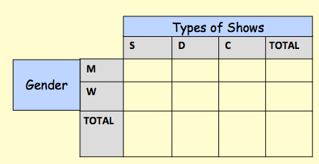
EX 1:Create a two way table
90 people were asked whether they preferred Soaps, Drama or Crime shows.
12 men said they liked Dramas
33 people in total said they liked Soaps, and 27 of these were women.
25 people in total liked Dramas best.
Only 10 women liked Crime shows.
4 Steps:
1.READ through everything first.
2. Find the CATEGORIES of the
information.
3. Create your TABLE & KEY (when needed)
4. FILL IN what you can.
Key: S=Soaps; Drama=D; Crime=C
M= Men; W=Women

Slide 3
Create a two way table
90 people were asked whether they preferred Soaps, Drama or Crime shows.
12 men said they liked Dramas
33 people in total said they liked Soaps, and 27 of these were women.
25 people in total liked Dramas best.
Only 10 women liked Crime shows.
Types of Shows
NOW WHAT?
Use deductive reasoning to solve for the missing values
 | S | D | C | TOTAL
M
W
TOTAL
Gender
6
12
22
40
27
13
10
50
33
25
32
90
Key: S=Soaps; Drama=D; Crime=C
M= Men; W=Women

Slide 4
Using Two Way Tables
How can two way tables be useful?
What is the probability that a pupil selected at random will be a boy?
 | Year 7 | Year 8 | Year 9 | TOTAL
Boys | 9 | 8 | 12 | 29
Girls | 4 | 10 | 7 | 21
TOTAL | 13 | 18 | 19 | 50
29/50
The probability of selecting a pupil that is a
a boy is 0.58.

Slide 5
Using Two Way Tables
How can two way tables be useful?
If a Year 7 pupil is selected, what is the probability that they will be a girl?
 | Year 7 | Year 8 | Year 9 | TOTAL
Boys | 9 | 8 | 12 | 29
Girls | 4 | 10 | 7 | 21
TOTAL | 13 | 18 | 19 | 50
4/13
The probability of selecting a pupil that is in Year 7 and is
a girl is 0.31.

Slide 6
Conditional Probability with Two way Tables
RECAP:
Finding the probability of an event given that something else has already happened
P(A | B) is read what is the probability of A given that B has occurred.
Review of Conditional Probability Formula:

