Slide 1
Intro to the Biogeochemical Cycles & The Carbon Cycle
Notes #15

Slide 2
What are the Biogeochemical Cycles?
ANS: They are the 4 different cycles that recycle carbon, water, nitrogen, and phosphorus within the Biosphere

Slide 3
What is the Carbon Cycle?
ANS: The recycling of carbon atoms between land, organisms, and the atmosphere

Slide 4
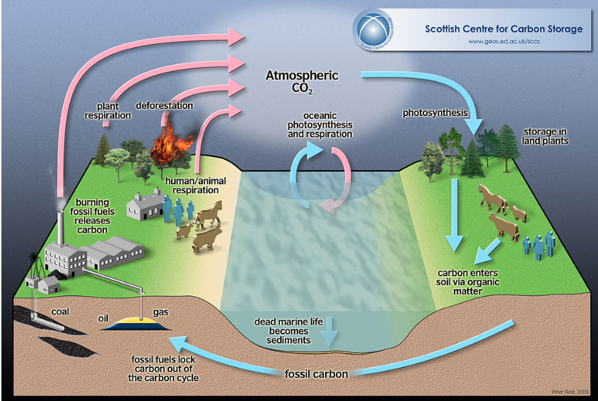
The Carbon Cycle
C) Deforestation
C)
D)
D) Algae Photosynthesis & Respiration
E) Photosynthesis
B)
E)
B) Plant Respiration
F)
F) CO₂ stored as Sugars
B)
B) Animal
Respiration
A) Fossil
Fuel Burning
A)
G)
G) Decomposition or Deposit of Organic Waste
H)
H) Formation of Fossil Fuel

Slide 5
A Closer Look of the Carbon Cycle
Putting CO₂ into the Atmosphere
(From Land)
A) Fossil Fuel Burning: Releases CO₂ into the air
B) Plant & Animal Respiration: Breathes out CO₂ into the air
C) Deforestation: Destroying forests releases CO₂ into the air
(From the Water)
D) Respiration by Algae: Breathes out CO₂ into the air

Slide 6
Returning CO₂ back on land & in water
E) Photosynthesis (Trees & Algae): Takes in CO₂
F) Plants & algae converts & stores CO₂ into sugars to
be used for food.
G) Organic matter released and stored in soil.
H) Fossil fuel forms from centuries of decomposed
organic matter.

Slide 7
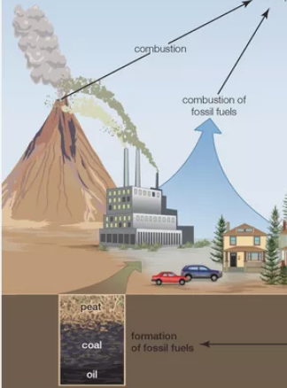
How did the Industrial Revolution & Growth of the Human Population Affect the Earth?
INCREASE
CO₂
ANS:
Increase use of fossil fuels to power cars and electrical plants contributed to carbon dioxide build up.

Slide 8
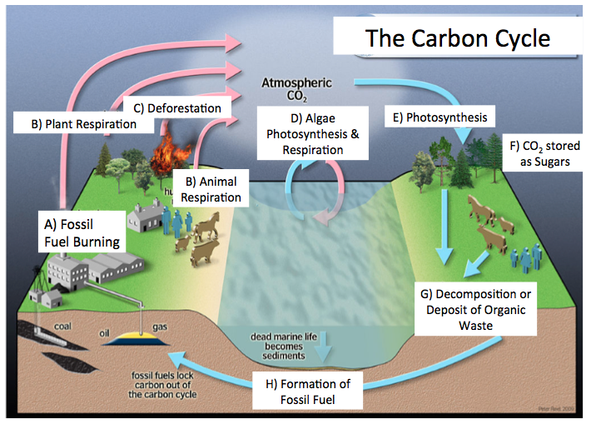
How did Deforestation & Clear Cutting “Break” the Carbon Cycle?
ANS: With limited trees, Photosynthesis decreases, and
amount of CO₂ can’t be converted into sugars to be used as food.
X
X

Slide 9
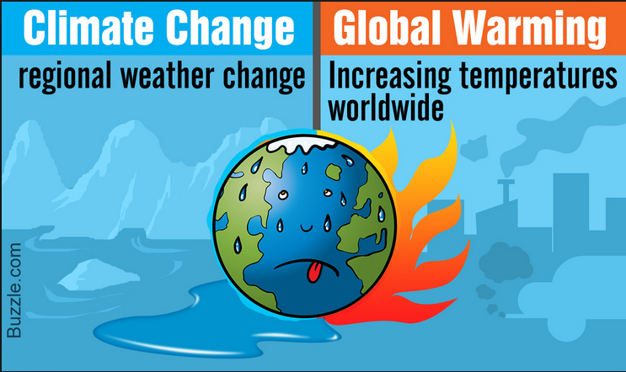
What is the Global Problem of High Amounts of CO₂ in the Atmosphere?
ANS: Climate Change and Global Warming

Slide 10
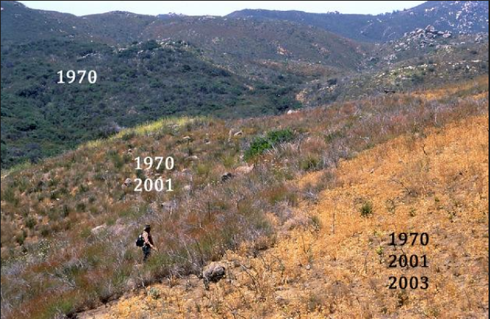
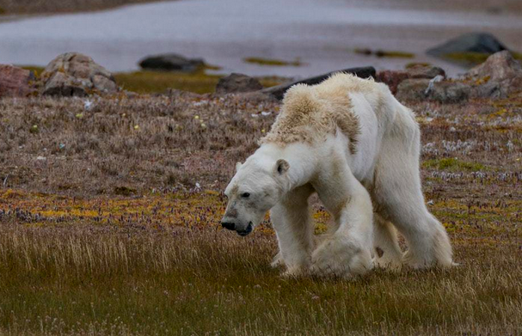
Problems are currently witnessing due to a “Broken” Carbon Cycle?
Loss of habitats & loss of biodiversity.
Ex. 2 Species Endangered or Extinction
Ex. 1 Habitat Loss Due to Severe Drought

Slide 11
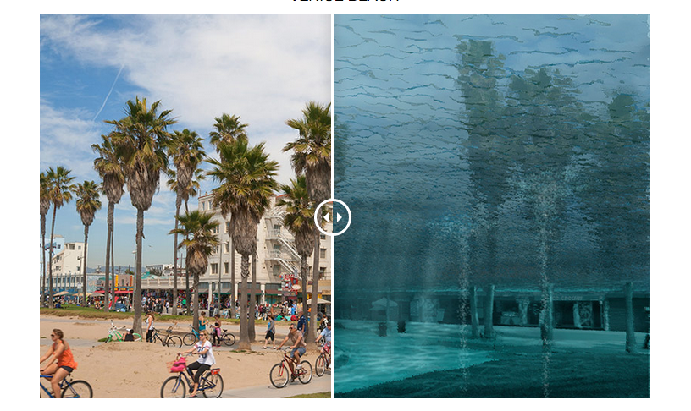
2) Rising of Sea Levels due to melting glaciers causing major floods and runoffs.
Ex. Venice Beach (CA) under water in year 2200,
where sea level rises to 25’.
2019
2200

