Slide 1
Conditional Probability with Two Way Tables
Notes #15

Slide 2
Conditional Probability with Two way Tables
RECAP:
P(A | B) is read what is the probability of A given that B has occurred.
Review of Conditional Probability Formula:

Slide 3
Example #1
What is the probability of selecting a person at random who
has brown hair, given they are a female?
Set up Problem
3
= 0.60
5
The probability of selecting a person at random who has brown
hair, given they are a female is 0.60.

Slide 4
Example 2a
203
=
= 0.62
325
The probability of a passenger on the Titanic surviving given they
were in first class was 0.62.

Slide 5
Example 2b
178
=
= 0.25
706
The probability of a passenger on the Titanic surviving given they
were in third class was 0.25.

Slide 6
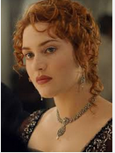
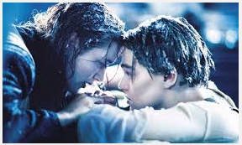
Survival for passengers given they were in First class was 62%
Survival for passenger given they were in Third class was 25%

Slide 7
Example 2c
212
=
= 0.30
711
The probability of a passenger being a crew member who survived the
Titanic was 0.30.

Slide 8
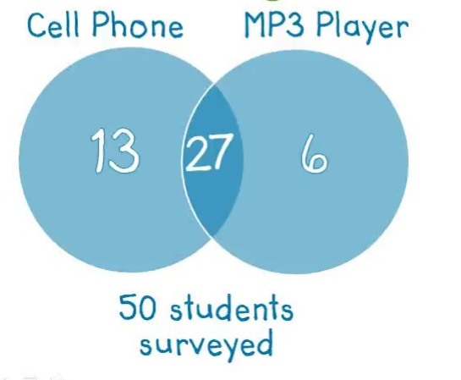
Using 2 Way Tables to Analyze Venn Diagrams
P(No Cell and No MP3): 4/50
 |  | Owns Cell Phone |  | TOTALS
 |  | Yes | No
Owns MP3 Player | Yes
 | No
TOTALS
Find:
P(Cell) : 27/50
P(Cell Phone Only): 13/50
P(MP3 Only): 6/50
P(MP3 or Cell Phone):
(27 + 6 + 13)/50 or 46/50
6
33
27
13
4
17
40
10
50

