Slide 1
Notes #15
Scatter Plots

Slide 2
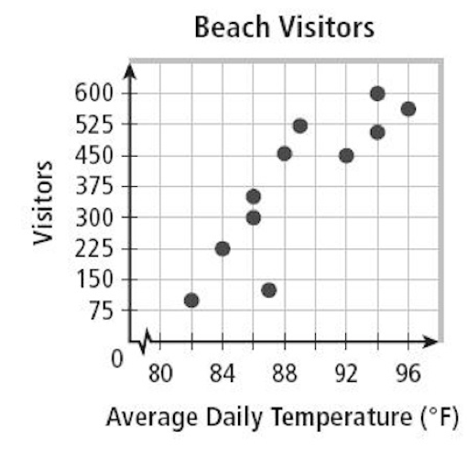
What are Scatter Plots?
ANS: A graph that relates two groups of data. Typically a plot of paired (x, y) quantitative data with a horizontal x-axis and a vertical y-axis
Ex.
Based on the scatter plot, what can we say about how temperature affects number of beach visitors?
ANS: Visitors go to beach more often on warmer days

Slide 3
What do Scatter Plots Determine?
ANS: To determine whether there is a relationship between the bivariate data (aka. two quantitative variables)

Slide 4
What does Bivariate Mean?
ANS: “Bi” means two, “Variate” means variables.
Variables are broken down into 2 types:
Dependent Variable (y-axis)
Independent Variable (x-axis)

Slide 5
Recap on the 2 types of Variables
1. Dependent Variable (on y-axis)
-It is what you measure and what is affected
during the experiment/study.
-It is called dependent because it "depends" on
the independent variable.
Ex. Student Test Scores
2. Independent Variable (on x-axis)
-It is the one that is changed by the scientist to see
how it affects the dependent variable
Ex. Amount of Time Spent Studying

Slide 6
Experimental Question
Do you think the amount of time/days spent studying would affect student test scores?

Slide 7
Exam Scores vs Days Spent Studying Scatter Plot (Max Score: 30)
To get a high score on the Bar Exam (for a Law License), how many days would you recommend to a person planning to take the exam?
ANS: Between 7 to 10 days.

Slide 8
Types of Scatter Plot Distributions
2 Types
1. Clustering – data values occurring close together.
2. Outlier – a data point with a value that is very different from the other data points in the set.

Slide 9
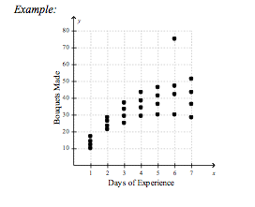
Which day(s) do you see the most clustered data?
Day 1: Cluster Range between 10-20 bouquets
Day 2: Cluster Range between 20-30 bouquets

Slide 10
Can you identify the Outlier out of the 4 people learning to make bouquets in this Scatter Plot?
ANS: With 6 days of bouquet
making experience, this person
Made about 78 bouquets,
where the avg bouquets made
on the 6th day is approx.
40 bouquets.
THAT’S 38 EXTRA BOUQUETS! Can we say “Over Achiever?”

Slide 11
Analyzing Scatter Plots with Statistical Correlation
Statistical Correlation
Understanding the relationship between two
variables that are statistically dependent.

Slide 12
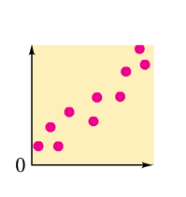
3 Types
1. Positive Correlation
Both sets of data increase together.

Slide 13
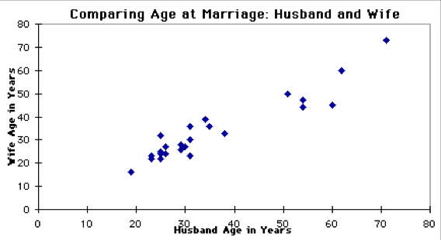
Positive Association Real Life Example Age of Wives vs Age of Husbands (N: 25 Married Men Surveyed)

Slide 14
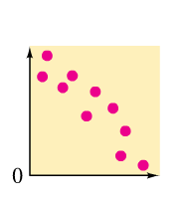
2. Negative Correlation
One set of data (x-axis value) increases as the other set (y-axis value) decreases.

Slide 15
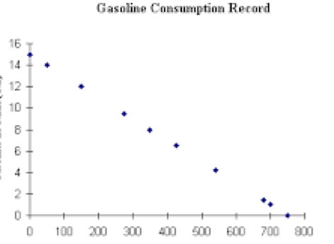
Negative Association Real-Life Example Amount of Gas Consumed vs Miles Traveled
Gas in Tank (Gal.)
Distance Traveled (miles)

Slide 16
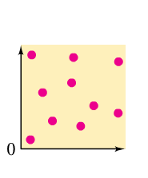
3. No Correlation
Sometimes data sets are not related

Slide 17
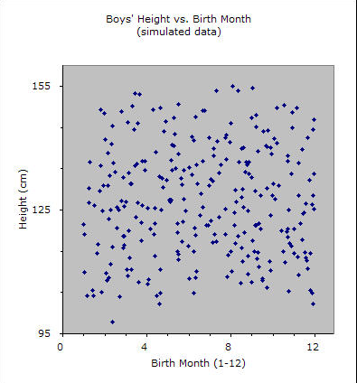
Real-life No Association Ex. Height of Boys vs Birth Months

Slide 18
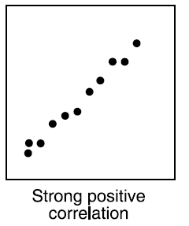
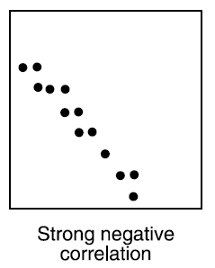
Strengths of Correlation
Strong Correlation – the data points cluster in a predictable pattern. Can almost put a straight line through the scatter plots.

Slide 19
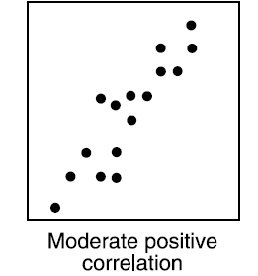
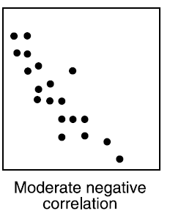
Weak/Moderate Correlation – the data points cluster loosely in a pattern that is less predictable.

Slide 20
Strong vs Moderate/Weak Correlation

Slide 21
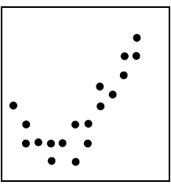
Non-linear Correlation

