Slide 1
The Normal Curve
Notes #1

Slide 2
Properties of the Normal Curve:
a. Also called Bell Curve or Gaussian Curve
b. Perfectly symmetrical normal distribution
c. The MEAN of a distribution is the MIDPOINT
of the curve
d. The tails of the curve are infinite
e. Mean = Median = Mode
f. The “area under the curve” is measured in
STANDARD DEVIATIONS from the MEAN

Slide 3
Properties (cont.)
g. Has a Mean = 0 and Standard Deviation (s) = 1.
h. General relationships: ±1 s = about 68.26%
±2 s = about 95.44%
±3 s = about 99.72%

Slide 4
Symbols for Normal Distributions
μ : the mean of a density curve.
σ : the standard deviation of a density curve.
All Normal distributions have this general shape.

Slide 5
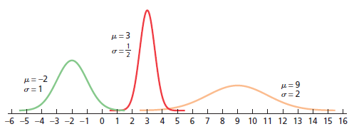
Three Examples of Normal Distributions
Different Means (μ) results in center of graph at different location on the x axis
Notes:
Change to page 274

Slide 6
Analyzing the Spread of the Normal Distribution
Different Standard Deviations (σ) results in varying spreads.
-Smaller the σ, the more NARROWER the spread of the curve
-Larger the σ, the more WIDER the spread of the curve

Slide 7
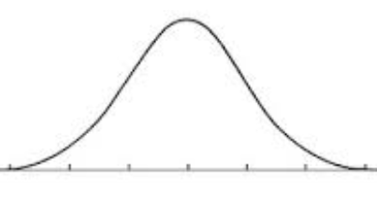
Guided Practice Problem
A set of data with a Mean (μ) of 10 and a Standard Deviation (σ) of 2, is normally distributed.
Given: (μ) = ______ (σ) = ______
a) Sketch & Label the Normal Curve
10
2
μ
−1σ
+1σ
−2σ
+2σ
−3σ
-2
+2
-2
+2
+3σ
-2
+2
___
___
8
10
12
14
16

