Slide 1
Notes #22
Calculating Variance with Grouped Data (Frequency Distributions)

Slide 2
Calculating Variance for Grouped Sample Data
Notation
Midpoint of interval
frequency
Degrees of freedom
n: Total # of values

Slide 3
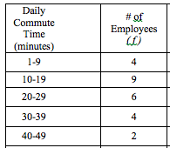
Example #1 .
The following gives the frequency distribution of the daily commuting time (in minutes) from home to work for a sample of 25 employees of a company
Calculate the , s² , and s of the daily commuting times

Slide 4
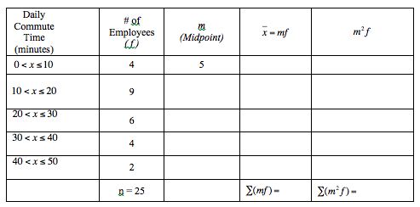
Calculate the , s² , and s of the daily commuting times

Slide 5
mins
mins
mins

Slide 6
FINAL ANSWER:
The average traveling time for the 25 workers to go from home to work is 21.4 mins., with a standard deviation of 11.86 minutes.

