Slide 1
Notes #23
Using Variance & Standard Deviation to Compare Data

Slide 2
Using Variance & Std Deviation to Assess Customer Service Efficiency for 3 Banks
Scenario: You have 3 banks with different wait line format.
Bank 1 has a manager monitoring the single wait line
Bank 2 has a single wait line (no monitoring)
Bank 3 has multiple lines
Question #1: If you are setting up a bank, which wait line format would you choose to best serve your customers?
Question #2: Which wait line format would be least efficient in providing customer service?
ANSWER the 2 Questions on a separate sheet of paper, and explain your selection. Turn in your responses. (5 minutes, this is your CLASSWORK)

Slide 3
Bank 1 (Manager-Controlled Line)
Manager

Slide 4
Bank 2 (Single Waiting Line)

Slide 5
“Bank 3” (Multiple Wait Lines)

Slide 6
Data
The following data table shows customer waiting times at three different banks.
Avg wait time
(mins)
Customer wait time (mins)
A
B
C
Manager-Controlled
6
6
6

Slide 7
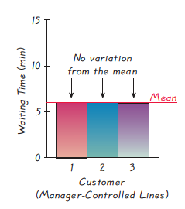
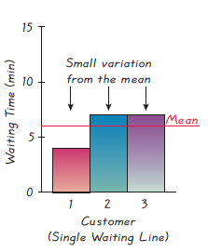
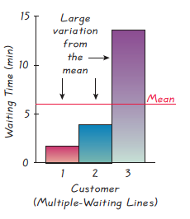
Graphs
For a visual illustration of variation, the bar graphs show customer waiting times at three different banks.
Bank 1
Bank 2
Bank 3

Slide 8
Bank 1 (Manager-Controlled Line)
All 3 customers waited 6 minutes (x) to be serviced.
Waiting time did not vary between customers.
Deviation from the Mean:
For all 3 customers:
Summary:
No variance or difference in wait time from the avg of 6 minutes for the 3 customers to be serviced in Bank 1.
= 6 min

Slide 9
Bank 2 (Single Waiting Line)
Customer 1 (C1) : 4 min wait
Customer 2 (C2) : 7 min wait
Customer 3 (C3) : 7 min wait
Deviation from the Mean:
C1: 4 – 6= - 2 min (2 min < Avg Wait)
C2: 7 – 6 = 1 min (1 min > Avg Wait)
C3: 7 – 6 = 1 min (1 min > Avg Wait)
Summary:
There is a small variance or little difference from the avg wait of 6 mins for the 3 customers to be serviced in Bank 2.
= 6 min

Slide 10
Bank 3 (Multiple Wait Lines)
Customer 1 (C1) : 1 min wait
Customer 2 (C2) : 3 min wait
Customer 3 (C3) : 14 min wait
Deviation from the Mean:
C1: 1 – 6= - 5 min (5 min < Avg Wait)
C2: 3 – 6 = - 3 min (3 min < Avg Wait)
C3: 14 – 6 = 8 min (8 min > Avg Wait)
Summary:
There is a large variance or big difference from the avg wait of 6 mins for the 3 customers to be serviced in Bank 3.
= 6 min

Slide 11
Statistical Analysis of the 3 Banks using Standard Deviation
Bank 1 (Manager Controlled)
Bank 2 (Single-Line)
Bank 3 (Multiple-Lines)
Variance: s²
Variance:
Variance:
Standard Deviation:
Standard Deviation:
Standard Deviation:

Slide 12
Data Analysis
Bank 1 has s = 0 mins, where there are no variation (s² = 0) of wait time b/w the customers.
Bank 2 has s = 1.7 mins, where there is a small variation (s² = 3) of wait time b/w the customers.
Bank 3 has s = 7 mins, where there is a large variation (s²= 49) of wait time b/w the customers.
CONCLUSION: Bank 1 is most efficient at providing the quickest customer service. There is no wait time variation (s² = 0) from the (6 minutes), and the s = 0 minutes.
Bank 3 is least efficient w/ 7 min wait time b/w customers

Slide 13
Conclusion
Among the 3 banks, Bank 1 (with a manager controlling the lines), is most efficient at providing the quickest customer service. There is no wait time variation (s² = 0) from the (6 minutes), and the s = 0 minutes.
Bank 3 (with multiple lines) is the least efficient in providing customer service, due to the largest difference of wait time (s² = 49 ) from the , with a s = 7 minutes.

