Slide 1
Population Density & Distribution
Notes #3

Slide 2
What is Population Ecology?
ANS: Studies the factors that affect the size &
the make up of a population

Slide 3
What do you study in Population Ecology?
2 Things
Population Density: # of individuals divided over a specific area
Distribution: pattern of spacing between individual species

Slide 4
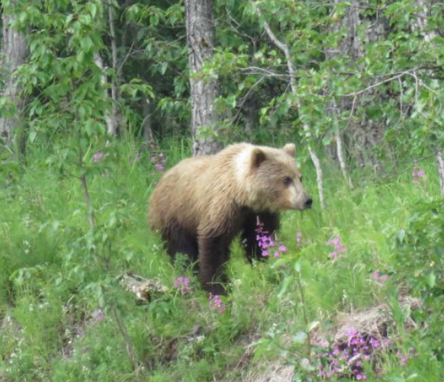
Types of Population Density
2 Types
Low Density: Individuals are spaced far apart from each other over a specific area.
Ex. Bears are solitary hunters and are at low densities.

Slide 5
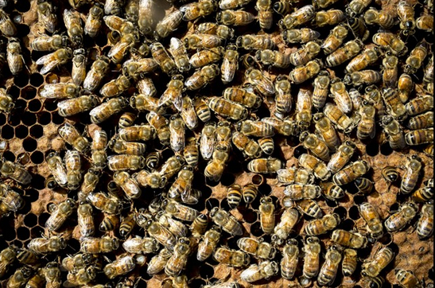
2) High Density: Individuals are spaced closer together over a specific area.
Ex. Bees living in a hive are at high density.

Slide 6
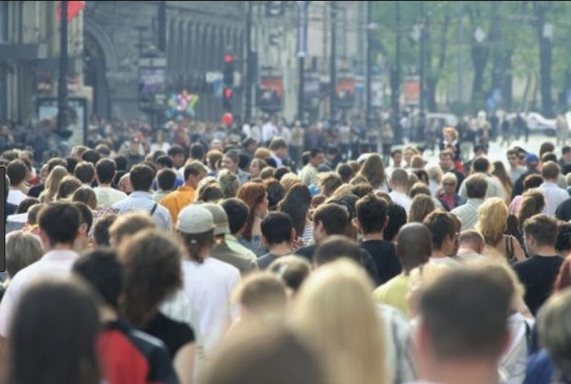
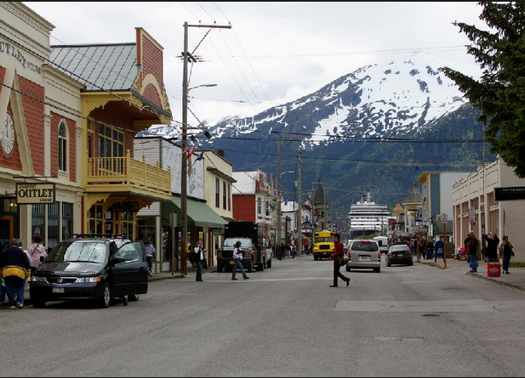
What Type of Population Density does the following show?
New York City, NY
Skagway, Alaska
High or Low Density?
High or Low Density?
HIGH
LOW

Slide 7
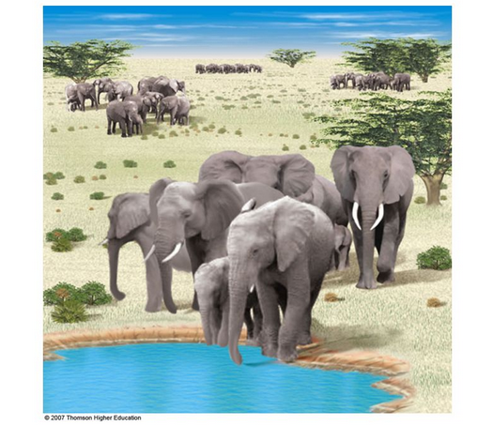
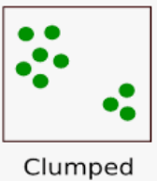
Types of Population Distribution Patterns
3 Types
Clumped: individuals are grouped in patches around resources to promote social interactions & for protection.
Ex. Herds of Elephants

Slide 8
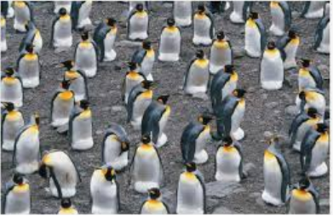
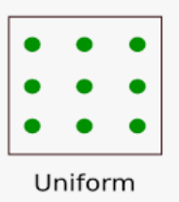
Uniform: individuals are evenly spaced apart from each other
Ex. Penguins are evenly spaced apart from each other

Slide 9
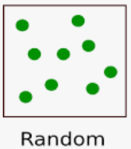
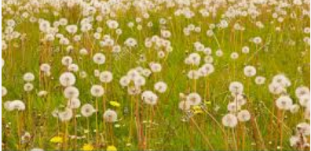
3). Random: Spacing between individuals is unpredictable and is randomly scattered.
Ex. Dandelions scattered randomly in a grass field.

