Slide 1
Z-Scores & Z-Tables analyzing Normal Curve
Notes #4

Slide 2
Using Z-Tables to Find Areas Below a Score
Use Z-Table to find the areas below a z-score.
First compute the Z score, taking careful note of the sign of the score.
Make a rough sketch of the normal curve and shade in the area in which you are interested.

Slide 3
Using z Table (cont.)
Z-Table has 2 types of information (a) & (b)
(a) = Z scores
( - ) Z score = below the mean
( +) Z score = above the mean
(b) = Area under the Normal Curve
(in decimals and should be converted to a %)

Slide 4
Finding Normal Percentiles by
Table A is the Standard Normal table. We have to convert our data to z-scores before using the table.

Slide 5
Using Z-Score Table A
Given: Z-score = +1.67
Step 1: Find the Z-score (+1.6) in the first column.
Step 2: Find the Second Decimal place in z (0.07) from the top of the Z Table
Step 3: Areas can be expressed as percentages:0.9525 x 100% = 95.25%
Step 2
(Z) | (0.06) | (0.07)
1.5 | 0.9406 | 0.9418
1.6 | 0.9515 | 0.9525
1.7 | 0.9608 | 0.9616
. | . | .
Step 1
Step 3

Slide 6
FINAL ANS: Normal curve with z=1.67, makes up 95.25% of the area below the curve.
Label the mean (0) in RED, & Z-Score in Blue on the Normal
Curve. Then Shade in the Area that is equal and less the z score.
μ
Z
-2
+2
-1
0
+1
+1.67

Slide 7
Practice Problem Using Z-Table
What if the Z score is negative (–1.67)?
The area below
Z = - 1.67 is 0.0475.
Z | .06 | .07
-1.5 | 0.0594 | 0.0582
-1.6 | 0.0485 | 0.0475
-1.7 | 0.0392 | 0.0384
. | . | .

Slide 8
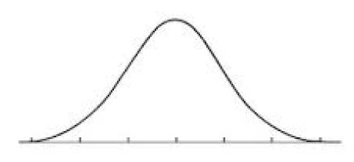
Using z table (cont.)
The area below Z = - 1.67 is 0.0475.
Area should be expressed as %:
0.0475 x 100% = 4.75%.

