Slide 1
Analyzing Z-Scores on the Normal Curve
Notes #5

Slide 2
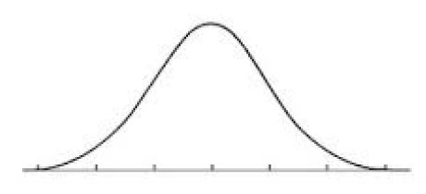
Ex 1. What is the area above the Z score (–1.67) or to the right?
Step 1: Find the percent associated with the Z-score
Z = -1.76, covers 4.75% of the Normal Curve
(which covers the area left of the Z score)
Step 2: To find the area above the Z-score., subtract
the % area covered from 100% (or from 1, if in decimal)
Step 3: SHOW WORK
100% - 4.75% = 95.25% OR 1 – 0.0475 = .9525
FINAL ANS: 95.25% of the Normal Curve is above z score -1.67.
μ
Z
95.25%
−1.67
0

Slide 3
Ex. 2 Determine the area of the Normal Curve if the z score is
between -2 and 1.53
Z₁
?
Z₂
91.42%
−2.00
0
1.53
Step 1: Find the percent associated with the Z-score
Z₁ = -2.00, covers 2.28% of the Normal Curve
Z₂ = 1.53, covers 93.70% of the Normal Curve
Step 2: To find the area between the Z-scores, subtract
the % area covered by Z₁ from Z₂
SHOW WORK: 93.70% - 2.28% = 91.42%
FINAL ANS: 91.42% of the Normal Curve is b/w z = -2.00 &
z = 1.53.

