Slide 1
Types of Species Interactions
Notes #5

Slide 2
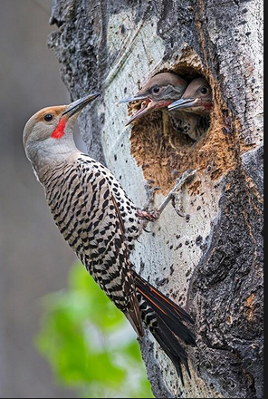
Symbiosis & Species Interactions
What is Symbiosis?
ANS: Describes interaction between two different organisms living closely together.
Ex. Woodpecker pecked a hole into a tree to build a nest for her babies.

Slide 3
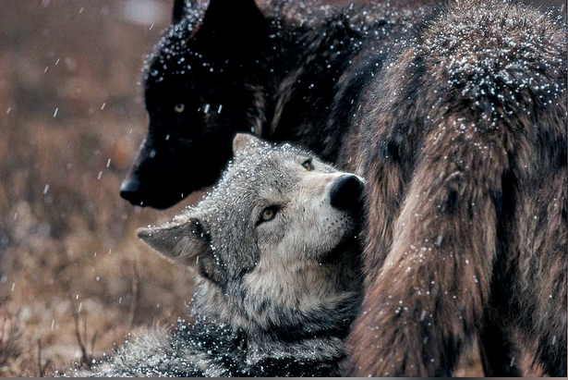
Types of Species Interactions
Two Types
1) What are Intraspecies Interactions ?
ANS: Relationships formed between the same species
Ex. The Alpha Wolf Pair: Usually the parents and
leaders of the pack. They keep social order and the
only ones who breed within the pack.

Slide 4
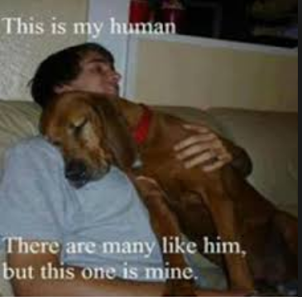
2) What are Interspecies Interactions?
ANS: Relationships formed between different species.
Ex. The bond between
humans & their dogs

Slide 5
Types of Interspecies Interactions
4 Types
Predation
(+, -): Win – Lose Relationship
Predator eats prey
Relationship benefits predator, and kills the prey.

Slide 6
Ex. Lion prey on and kills zebra for food

Slide 7
2) Parasitism
(+, -): Win – Lose Relationship
Predators/parasites live in/on and feed off of the host without killing it.
Relationship benefits parasite, and harms the host
Ex. Mosquitos feeding off blood from mammals

Slide 8
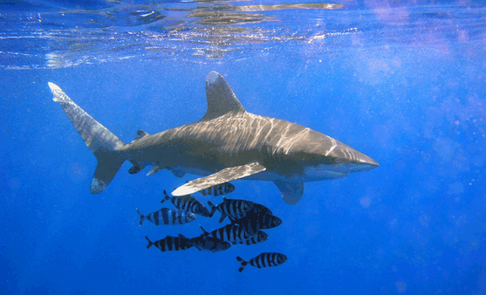
3) Commensalism
(+, 0) Win – Neutral Relationship
interaction between organisms that benefits one organism but has little or no effect on the other.
Ex. Pilot fish benefits
from the shark for
protection and food from
left over kill. No effect on
sharks.

Slide 9
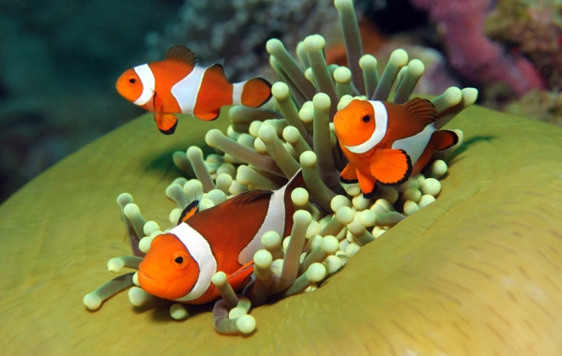
4) Mutualism
(+, +): Win – Win Relationship
Interaction between two species where both benefit from the relationship.
Ex. Clownfish fight off predators of anemones
The Sea anemones provides shelter for the clownfish

