Slide 1
Notes #6
Ch 1-4: Design of Experiments

Slide 2
How to collect statistical data?
2 ways
Observational studies
- By observing and measuring specific traits, without
changing the subjects being studied.
Ex. Gallup Poll was established in 1935 to collect public opinion by polling and surveying a worldwide population.

Slide 3
2. Experiment
-When some treatment is applied and then
observations are made to see its effects on the
subjects.
Ex. Giving caffeine pills to 100 college freshmen during finals weeks, and measuring amount of hours they can go without sleeping while studying.

Slide 4
Types of Observational Studies
3 types
Cross-sectional study
- Data are measured and collected at one point in
time, usually a short term study (≤ 1 year study).
Ex. E-cigarettes and conventional cigarette use among US
adolescents (2014 Cross Sectional Study )
“The study, which tracked the habits of nearly 700 young people over a year, revealed that young nonsmokers who showed no interest in smoking were more likely to take up the habit if they had used electronic cigarettes.”
Khan, A., (2015, September 8) E-cigarettes: Teens who vape are more likely to smoke later, study says. Los Angeles Times. Retrieved from http://www.latimes.com

Slide 5
2. Retrospective (Case-control) Study
- Data collected by going back in time via examining
records, interviews, etc.
Ex. Japanese Internment Camp Experience recapping the
lives of survivors who lived through a traumatic
experience.

Slide 6
3. Prospective Study (Longitudinal or Cohort Study)
- Data gathered from the same subjects repeatedly
over a period of time (usually years or decade long
studies).
Ex. Cell phone use linked to Brain Cancer
Swedish Longitudinal Study conducted for 15 to 25
years

Slide 7
1. Cross-sectional study
- Data are measured and collected at one point in
time, usually a short term study (≤ 1 year study).
2. Retrospective (Case-control) Study
- Data collected by going back in time via examining
records, interviews, etc.
3. Prospective Study (Longitudinal or Cohort Study)
- Data gathered from the same subjects repeatedly
over a period of time (usually years or decade long
studies).

Slide 8
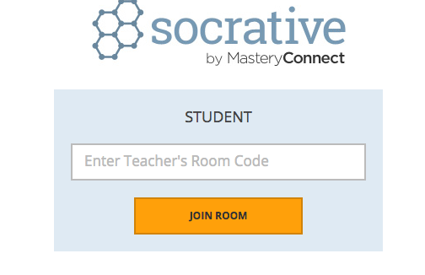
Quick Check

Slide 9
Designing an Experiment
(The Scientific Method: A 6 Step Process)
Stating a Problem.
Forming a Hypothesis (“If…, then…” statement)
Setting Up the Experiment
a. Control Group:
A sample group that is left untreated
or given a placebo, and is used to compare to
the experimental sample group.
b. Experimental Group:
Sample group receiving the treatment.
Be aware of the Placebo Effect (subjects who were untreated may report the same effects as the experimental group. It maybe true or imagined).

Slide 10
The Scientific Method Cont’d
4) Setting Up the Variables (3 Types)
a) Independent Variable:
The single “thing” that is CHANGED and has
made the experimental group different from
the control group.
b) Controlled Variables: Materials/conditions kept
constant between the experimental and control
group
c). Dependent Variable:
What you expect to see or measure as a
result from the Independent Variable.

Slide 11
The Scientific Method Con’t
5) Recording and Analyzing Data.
6) Drawing a Conclusion.

Slide 12
Quick Check II
You have been given pinto beans to plants and
your experiment is to see how much water you
will need to grow the tallest plant in 2 months.
Identify the following:
Two Controlled Variables
The Independent Variable
The Dependent Variable

Slide 13
Quick Check Answers
Controlled Variables
-Type of seeds (Pinto Bean)
-Amount of time for growth (2 months)
-Type of soil, location, pots…etc.
b)Independent Variable
-Amount of Water
c) Dependent Variable(s)
-Amount of growth

Slide 14
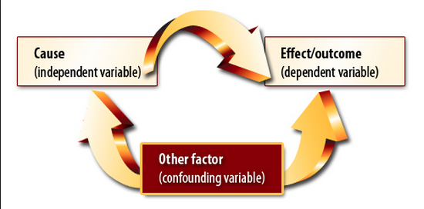
How to Ruin Experimental Results
2 ways
1. Confounding factors/variables
- Occurs in an experiment where you cannot
distinguish or tell what led to the change in the
final results.

Slide 15
2. Failure to collect a representative sampling of the population
Ex. 5 teachers voting to have a 3 week Winter Break, do not represent the entire faculty and staff in the AUSD. 2/3 vote is needed to pass a new vacation proposal.

Slide 16
What is wrong with this experiment?
Ex. You want to determine whether or not the amount of light would affect the height of a plant. You adjust different amount of light for each plant, and placed each plant in different potting soil.
Was a confounding factor introduced in the experiment?
ANS: Yes. The different potting soil will directly influence the growth of the plants, so you can’t determine if it’s the light amount or the soil type that is making a difference in the results.

Slide 17
How to avoid experimental problems
1. Control the effects of the variables
ex. Blinding or double blind or rigorously controlled
design.
2. Conduct multiple trials and/or have large sample sizes
3. Use randomization
ex. Let chance group the subjects.

