Slide 1
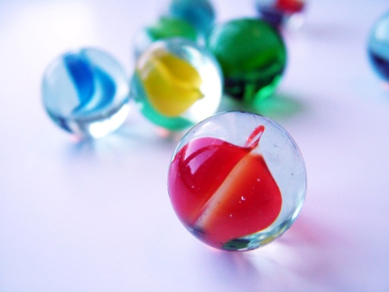
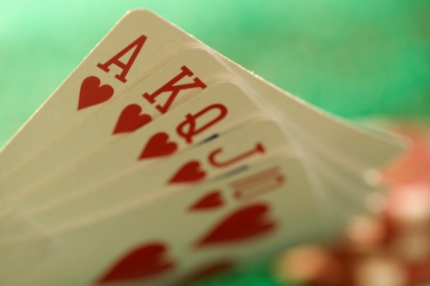
Notes #6
Ways to Determine the Probability of a Certain Outcome

Slide 2
Principles of Probability
What is it?
ANS: Determine the chance that an event will happen

Slide 3
2 Things to Identify
1) Outcome: a result of an experiment (ex: Sex of a Newborn Child = 1 outcome)
2)Sample Space: a list of all the possible outcomes of an experiment
(ex. Sex of a Newborn Child: 2 possible)

Slide 4
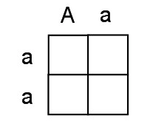
Using Punnett Squares to Calculate Probabilities
What are Punnett Squares?
ANS: They are a graphical way of reproducing the basic rules of probability.

Slide 5
What is the Probability of Predicting the Sex of a Baby?
Background Information:
Sex of a Normal human is determined by 2 sex chromosomes.
Ex.
As a healthy male, you should be a: XY
As a healthy female, you should be a: XX

Slide 6
Story 1 (Starting a family)
What is the probability that the newly
weds, Kevin & Connie will have a boy as
their first born child?
Notation for Probabilities: P(event)
Ex.
Probability of having a son: P(Son)
Probability of having a daughter: P(daughter)

Slide 7
Story 1
P Kevin x Connie
___ ___ ___ ___
X
Y
X
X
Gamete
Cells
X
Y
X
X

Slide 8
Using Punnett Squares to Predict Outcomes
What is the probability that the newly-weds, will have a boy as
their first born child? P(boy)
X
X
_______
_______
X
X
X X
Sample Space (Possible Outcome): 4
X
_______
Total Possible Boys:
2
X Y
X Y
XY possibility:
Y
_______
ANS: The chance that Kevin & Connie will have a boy is: P(Son):
.50

Slide 9
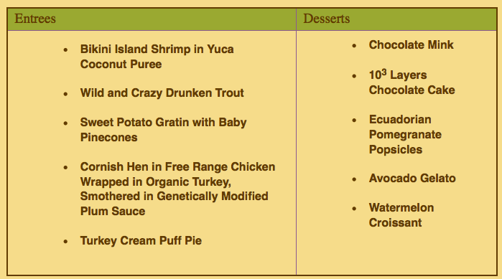
Ordering an Entrée & Dessert from a Chez Punnett Menu
Using a Punnett Square to determine the # of meal combinations with 5 Entrees & 5 Desserts

Slide 10
Creating combinations at Chez Punnett
Step #1:Make a square with possible entrees on the top and possible desserts on the side.
Step #2:
Each box within the square represents a possible meal.
STEP #3: Complete the Punnett Square
STEP #4: Determine the # of meal combinations with 5 Entrees & 5 Desserts
ANS: 5 entrees x 5 desserts = 25 possible meals

Slide 11
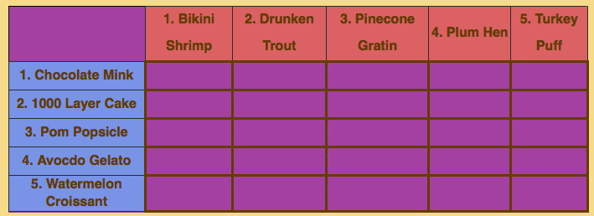

Slide 12
What is the probability that a customer will order the
Shrimp and Watermelon Croissant? (Refer to the above Punnett Square)
_______ total possible outcomes, but only _____ combination for Shrimp & Watermelon Croissant.
Use P( combination) as notation
FINAL ANS: The P(Shrimp & Watermelon Croissant) is or 0.04 or 4%.
25
1

Slide 13
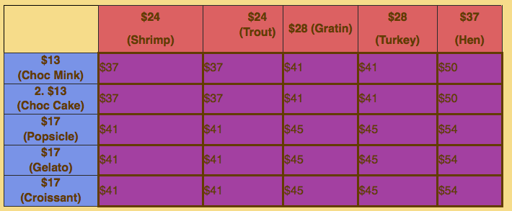
How Much Will a Meal Cost Me?
(Using Punnett Square)
Notice that many meals cost the same amount when totaled up?
Possible Outcomes: 5 Entrees x 5 Desserts = 25 Outcomes
P(Meal I can afford for $40): 4 of 25 or .16 or 16% of the menu

Slide 14
How Much Will a Meal Cost Me?
(If I have a $50 Budget, how many options do I have?)
P(Meal I can afford for $50 or Less): ____ of ____
P(Meal for $50 or Less): .88 or 88% of the menu
Life Lesson: Bring Enough Money to Increase Your Options!

Slide 15
Practice Problems
Ex) What is the probability of selecting an Ace out of a deck of cards? (Total Cards: 52)
ANS: P(Ace) = 4 of 52 or
Try) a) P(king) = 4 of 52
b) P(hearts) = 13 of 52
Try) On a number cube (di), what is the… a) P(odd) = b) P(less than 7) = c) P (2 or 3) = d) P(prime) =

