Slide 1
Notes #7 Ch 1-4 Con’t: How to Avoid Experimental Problems

Slide 2
How to avoid experimental problems
Minimize Placebo Effects.
Limiting extraneous/compounding variables.
Conduct multiple trials and/or have large sample sizes
Use randomization

Slide 3
A. How to Minimize the Placebo Effect
2 Ways
Blinding
Technique where the subject does not know whether he/she is receiving a treatment or a placebo.
Ex. You tell the subjects that the pill is either treatment or a placebo, and the experimenter will only reveal the truth after the completion of the study.

Slide 4
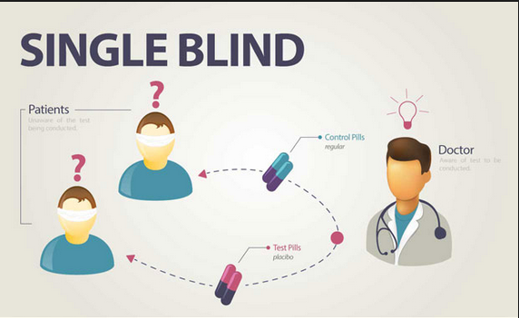
Single Blind Study

Slide 5
2. Double blinding
-Both subjects and researcher assistants do not know which one is the placebo or the treatment, truth is only known by the primary researcher or drug company.
Primary Researcher
Placebo
Subject #1
Subject #2
Treatment

Slide 6
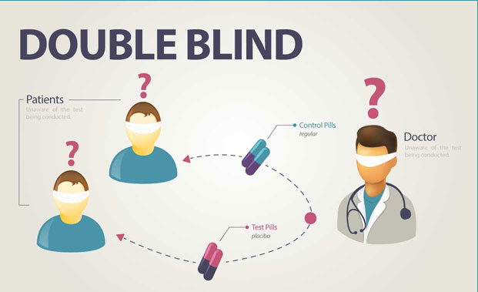
Double Blind Study

Slide 7
B. Limiting Compounding Variables
1. Rigorously Controlled Design
-Carefully select subjects to be given the treatment and placebo.
Ex. Test effectiveness of a drug to lower blood pressure on 30-year-old males.
Treatment Group
Subjects: 30-year-old non-smoker white males with high fat salt diet.
Placebo Group
Subjects: 30-year-old non-smoker white males with high fat salt diet.

Slide 8
C. Sampling Strategies
5 types
Simple Random Sampling (SRS)
-Look at population as a whole and randomly selects from population without any criteria
Ex. Using computer to generate random student id numbers to select 10 lucky winners for new laptop.

Slide 9
2. Systematic Sampling
Select subjects based on a fixed nth record from the total population.
Ex. Every 5th student in the lunch line is asked to take a survey about how tasty is the cafeteria food .

Slide 10
3. Convenience Sampling
Selecting subjects due to researcher’s convenience.
Ex. Asking the people sitting next to you in class to fill out a student survey.

Slide 11
4. Stratified Sampling
3 steps
a. the population is first broken into subsets based on specific criteria
b. one common characteristic.
c. The members of subsets are selected at random
Ex . People with same gender being chosen randomly.

Slide 12
5. Cluster Sampling
3 Steps
Divide population into sections (or clusters)
Then randomly select from clusters
Lastly, choose all members from the selected cluster to participate in study.

Slide 13
Sampling Errors
2 types
Sampling Error:
-Difference between a sample result and the true
population result.
Non-sampling error (Experimenter’s Error)
- Sample data are incorrectly collected, recorded,
or analyzed.

