Slide 1
Notes #9 Creating Dot Plots & Reading Frequency Tables

Slide 2
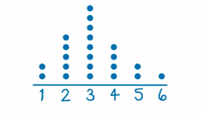
Dot plots
A graphical display of data using dots to represent each data point on a number line.
Ex

Slide 3
Sample Problem
Ms. Ng asked a class of 30 students,
“How many minutes did you take to eat breakfast this morning?”
Use a Dot plot to represent the results.

Slide 4
How to make a Dot plot
Collect raw data and organize into numerical order.
a. Raw Data of Minutes it took to eat Breakfast (N: 30 students)
b. Organized Data:

Slide 5
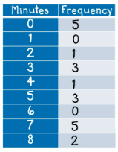
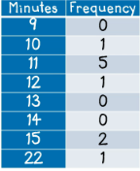
Organized Raw Data:
2. Create a Frequency Table to track how often each data point occurred.

Slide 6
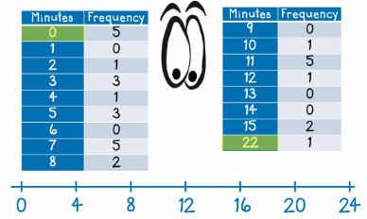
3a. Determine set intervals to create the number line
-Intervals should be nicely spaced and not crowded.
-Tick marks should be evenly spaced or of equal width from each other.

Slide 7
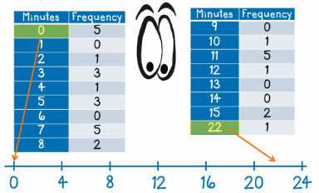
3b. Always include the min & max value in the number line
Special Note:
Number line does not have to start with the min and end w/ the max value.

Slide 8
4. Place a dot to represent data
Stack up dots above the matching numbered tick marks.
Time (mins)

Slide 9
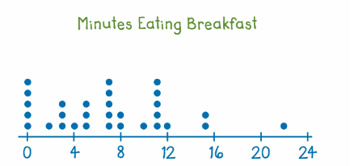
5. Include a title for the dot plot
Completed Dot Plot
Time (mins)

Slide 10
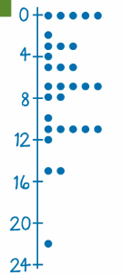
2nd way to display a dot plot
-On a vertical axis

Slide 11
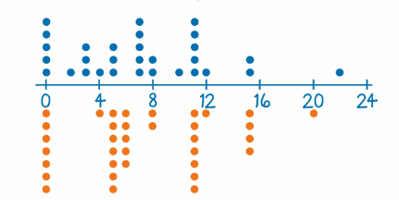
Displaying 2 data sets on a dot plot
Data from Ms. Ng’s Class vs. Ms. Hake’s Class can be compared on a Dot Plot
Ms. Ng’s Class
Ms. Hake’s Class

Slide 12
Purpose of Frequency Distribution (or Frequency Table)
Shows how a data set is divided among of several categories (or classes)

Slide 13
How is a Frequency Table Displayed?
ANS: Displayed as a list of all of the categories along with the number (frequency) of data values in each of them.
Ex. IQ Score and the Number of People Tested (Frequency)
IQ Score | Frequency
50-69 | 2
70-89 | 33
90-109 | 35
110-129 | 7
130-149 | 1

Slide 14
How to READ at a Frequency Table?
5 things to look for
Lower Class/Group Limit
Upper Class/Group Limit
Class/Group Boundaries
Class/Group Midpoints
Class/Group Width
IQ Score | Frequency
50-69 | 2
70-89 | 33
90-109 | 35
110-129 | 7
130-149 | 1

Slide 15
IQ Scores of Sample Group
IQ Score | Frequency
50-69 | 2
70-89 | 33
90-109 | 35
110-129 | 7
130-149 | 1
1. Lower Group/
Class Limits
are the smallest numbers that can actually belong to different classes/groups.
Ex. Min Score per IQ Group:
50; 70; 90; 110; 130

Slide 16
IQ Scores of Sample Group
IQ Score | Frequency
50-69 | 2
70-89 | 33
90-109 | 35
110-129 | 7
130-149 | 1
2. Upper Group/
Class Limits
are the largest numbers that can actually belong to different classes/groups.
Ex. Maximum IQ Score per group/class: 69; 89; 109; 129; 149

Slide 17
IQ Scores of Sample Group
IQ Score | Frequency
50-69 | 2
70-89 | 33
90-109 | 35
110-129 | 7
130-149 | 1
49.5
69.5
89.5
109.5
129.5
149.5
3. Class
Boundaries
are the numbers used to separate classes.

Slide 18
IQ Scores of Sample Group
IQ Score | Frequency
50-69 | 2
70-89 | 33
90-109 | 35
110-129 | 7
130-149 | 1
59.5
79.5
99.5
119.5
139.5
4. Class
Midpoints
are the values in the middle of the classes and can be found by adding the lower class limit to the upper class limit and dividing the sum by 2.
Ex. [50 + 69] ÷ 2 = 59.5
[70 + 89] ÷ 2 = 79.5
etc….

Slide 19
IQ Scores of Sample Group
IQ Score | Frequency
50-69 | 2
70-89 | 33
90-109 | 35
110-129 | 7
130-149 | 1
20
20
20
20
20
EX. 70 – 50 =
90 – 70 =
5. Class Width
is the difference between two consecutive lower class limits or two consecutive lower class boundaries.

Slide 20
Notes # 10 How to Analyze Dot Plots?

Slide 21
How to Analyze Dot Plots?
6 things to look for
Min & Max Values
The Range
Mean
Mode
Median
Overall Distribution of the data frequency

Slide 22
Sample Problem #1
Determine the following:
Minimum and Maximum Value
ANS: Minimum Value is 56; Maximum Value is 92.
2. Determine the Range
Maximum Value – Minimum Value = Range
ANS: The range is 92 – 56 or 36 bpm

Slide 23
3. Determine the Mean [Average Beats per Minute (bpm)]
Mean = Sum of Data Values ÷ Number of Data Values
[2(56) + 2(60) + 3(64) + 6(68) + 5(72) + 4(76) + 4(80) + 2(84) + 88 + 92]
30
= 2164 ÷ 30
= 72.13 or approximately 72 bpm

Slide 24
4. Mode
- It is the frequently seen value in the data set.
Ex. Determine the Mode of the Dot Plot above
ANS: The mode is 68 bpm, because it has the tallest stack.

Slide 25
Sample Problem #2 Determining the Median
Organizing data set in ordinal sequence.
Count number of data presented.
Ex. N = 14
Determine the Median/Center Value of the data set.
1st Half of N = 7 2nd Half of N=7
Median is [60 + 63] ÷ 2 = 61.5

Slide 26
What the Dot Plot looks like for the above data set.
When a Dot Plot has 2 Modes (i.e., 54 & 68), it is said that this data set is Bimodal. (“Bi”= Two; “Modal” = Modes)

Slide 27
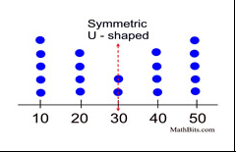
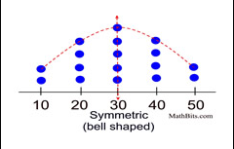
Using Frequency Distributions to Understand Data
3 types of Frequency Distributions
1. Symmetrical Shape
-When the graph is divided in the center, the right and left side are close to a mirror image of each other.
Ex 1. Normal Bell-Shaped Curve Ex 2. Symmetrical U-Shaped
Graphic Source: Mathbitsnotebook.com

Slide 28
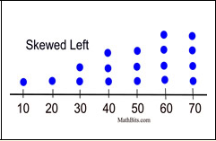
2. Skewed Distribution
Skewed Left
- Distribution of frequency is more spread out to the left
(“Tail” of graph on the left)
Ex. Skewed Left Dot Plot
Graphic Source: Mathbitsnotebook.com

Slide 29
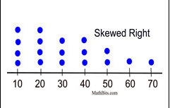
b. Skewed Right
- Distribution of frequency is more spread out to the right
(“Tail” of graph is on the right)
Ex. Skewed Right Dot Plot
Graphic Source: Mathbitsnotebook.com

Slide 30
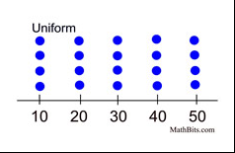
3. Uniform Shaped
The data is spread equally across the range.
No peaks in these graphs
Ex.
Graphic Source: Mathbitsnotebook.com

Slide 31
What Mean & Median tells us?
The mean and the median of the distribution are numerical summaries of the center of a data distribution.

Slide 32
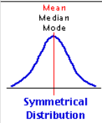
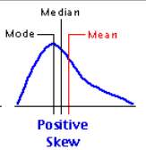
USING MEAN, MEDIAN, & MODE TO ANALYZE DATA DISTRIBUTION
1) Symmetrical Distribution
- Mean = Median = Mode
2) Right Skewed (Positively Skewed)
- Mean > Median > Mode
- Wider spread of distribution of data
with larger values.

Slide 33
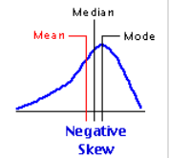
3) Left Skewed Distribution (Negative Skew)
- Mean < Median < Mode
- Wider distribution of data with smaller
values.
(“Little Mean Median ran away
from the Mode”)

Slide 34
DOTPLOT ReView
Log on to

