Slide 1
Group behaviors

Slide 2
Questions to considered
In terms of being able to survive….
What are the benefits to the species for them to clump together?
What are the benefits to an individual for them to be clumped together?
Is there a disadvantage or danger the species risks by being together?
Are there any disadvantages or danger that an individual may face by being part of the group?
In terms of reproduction….
What are the benefits to the species for them to clump together?
What are the benefits to an individual for them to be clump together?
Is there a disadvantage for the species by being together in a group?
Are there any disadvantages an individual may face by being a part of the group?

Slide 3
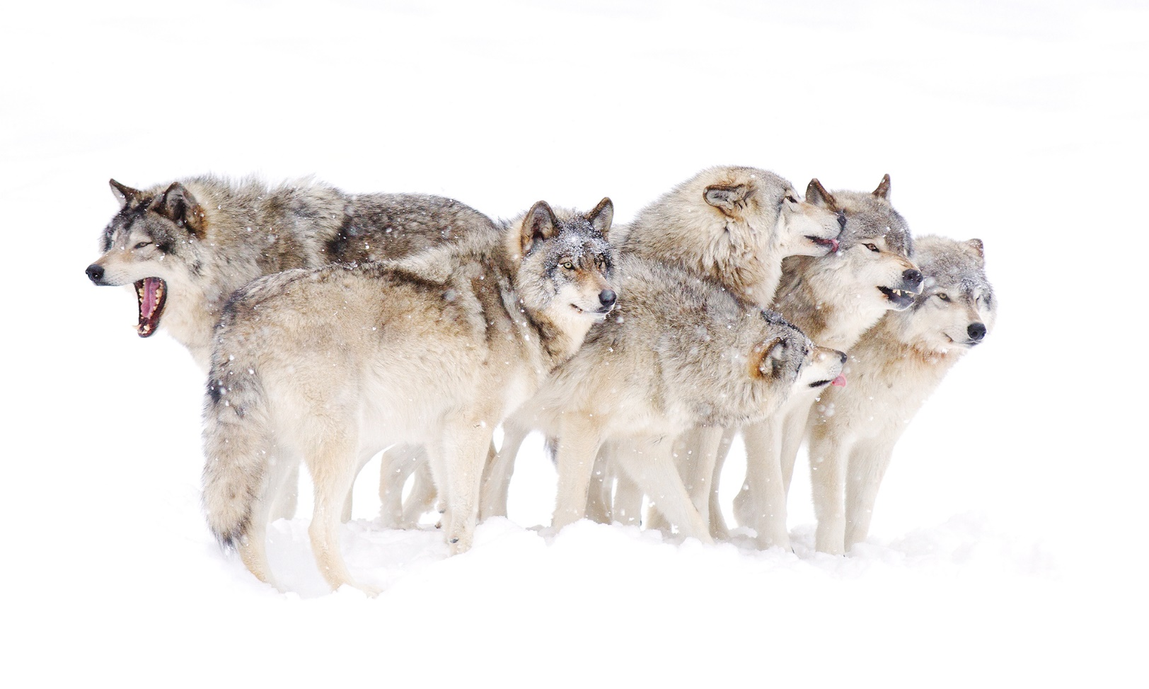
Pack of wolves
Read #170, #175, #177

