Slide 1
Notes #16
Drawing a Best-Fit Line on a Scatter Plot Graph & Making Predictions

Slide 2
What is a Line of Best Fit/Trend Line?
ANS: A line of best fit (or "trend" line) is a straight line that best represents the data on a scatter plot.
This line may pass through some of the points, none of the points, or all of the points.

Slide 3
What is the purpose of the Best-Fit-Line on the Scatter Plot?
Understand how the independent variable (x-axis) affects the dependent variable (y-axis) or the relationship between the variables.
For predictive purposes
Ex. Predicting chances of an earthquake on
the San Andrea Fault.

Slide 4
How to Determine the Best-Fit-Line?
Take a look at the data and ask yourself these questions.
Does the data look like a line? or a big blob?
What is the correlation of the scatter plots? (Positive or Negative correlated, and strength?)
If you cross your eyes, can you see a thick line trending in one direction or another?

Slide 5
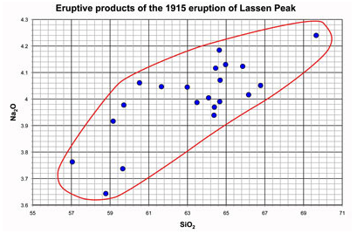
Constructing a Line of Best Fit. (4 Steps)
Plot data (scatter plots)
Draw a shape that encloses all of the data, (try to make it smooth and relatively even).
Ex.

Slide 6
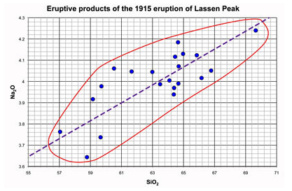
3. Draw a line that divides the area that encloses the data in two even sized areas.
Ex.

Slide 7
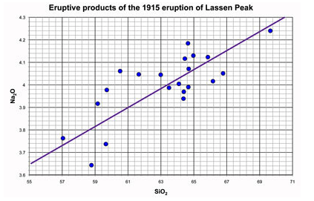
4. You have just constructed a best fit line through the data!
Ex.
Note that it is not necessary for the line to pass through ANY of the points on the plot, it is only important that your line bisect (cut in half) the area that encloses the data points

Slide 8
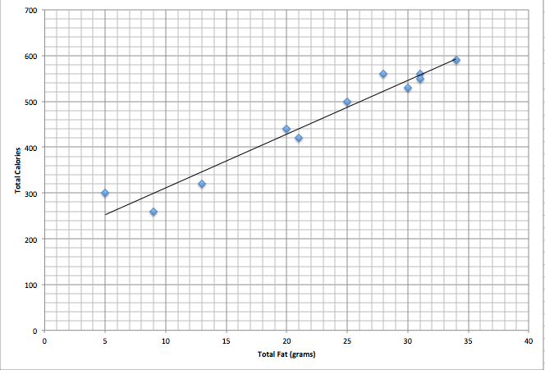
How to use the Line of Best Fit to Predict Future Outcomes?
1. Find two points that is on the "best-fit" line.
Ex.
Is there a relationship between the fat grams and the total calorie in fast food?
Points Selected:
(9, 300) &
(26, 500)
Other points can be selected.

Slide 9
2. Calculate the slope of the line through your two points (rounded to three decimal places).
Points Selected:
(9, 300), (26, 500)
Slope of a line
m= [ y₂-y₁] ÷ [x₂ – x₁]
m = [500-300] ÷[26-9]
= 200 ÷ 17
≈ 11.765

Slide 10
3. Write the equation of the line
Algebra 1 Review
Equation of the line: y – y₁ = m(x – x₁)
Substitute the first coordinate (9, 300) into the equation, given that the slope is, m ≈ 11.765
y – y₁ = m(x – x₁)
y – 300 = 11.765 (x – 9)
y = 11.765 (x – 9) + 300
This equation can now be used to predict information that was not plotted in the scatter plot.

Slide 11
Problem #1: Predict how many Calories are in 22 grams of fat.
y = 11.765 (x – 9) + 300
You are solving for “y” which represents Calories, given that x = 22
y = 11.765 (22 – 9) + 300
y = 11.765 (13) + 300
y = 152.945 + 300
y = 452.945
ANS: There are 452.945 Calories in 22 grams of Fat.

Slide 12
Predicting
If you are looking for values that fall within the plotted values, you are interpolating.
If you are looking for values that fall outside (of the plotted values (ex. outliers), you are extrapolating.
BE CAREFUL when EXTRAPOLATING. the further away from the plotted values you go, the less reliable is your prediction.

Slide 13
Final Thoughts
It is possible, that someone else will choose a different set of points, and their equation will be slightly different.
Your answer will be considered CORRECT, as long as your calculations are correct for the two points that you chose.

Slide 14
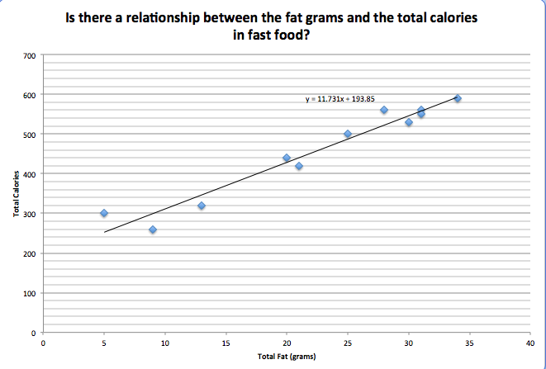
Best-Fit line Equation
Generated from Excel vs Best-Fit line Equation by hand
y = 11.731x + 193.85 y = 11.765 x + 194.12

