Slide 1
Notes #8 Ch 2-1: Summarizing & Graphing Data
How to Create Bar Graphs

Slide 2
Types of Graphics
Describing Data Graphically.
8 Main Graphs in Statistics
Pie Charts
Bar Graphs
Dot Plots

Slide 3
4. Stem & Leaf Plots (aka.: Stem Plots)
5. Histograms
6. Boxplot
7. Scatter Plot
8. Line Graphs

Slide 4
Graphing Categorical Data
2 types
Pie Charts (Review)
Display categorical data (specifically for nominal data)
Each slice/section represents relative proportion or % of each category out of the total data points.

Slide 5
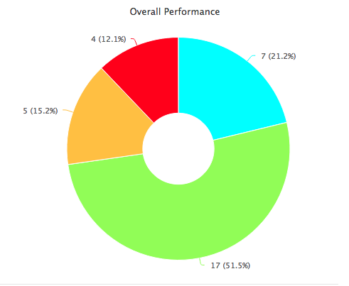
Per 2 Ch 1 Test M/C Results
N= 33
Per 2 Avg: 68%
16 /22;

Slide 6
2. Bar Graphs
Use bars of equal width to show frequencies of categorical, or qualitative, data.
Vertical scale (y-axis) represents frequencies or relative frequencies.
(Ex. Number Count, %, Height, Distance, etc… )
Horizontal scale (x-axis) identifies the different nominal data. (Ex. Colors, Race Groups, Grades, etc…)

Slide 7
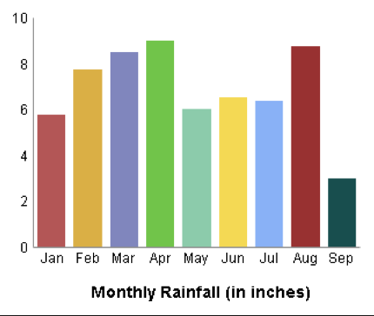
What are Bar Graphs Good For?
a. Plotting data that spans many months (or days,
weeks, or years...)
Ex. Monthly Rainfall in the Amazon Rainforest
Amount of Rainfall (inches)

Slide 8
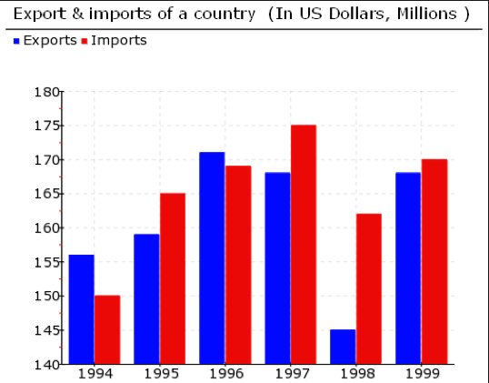
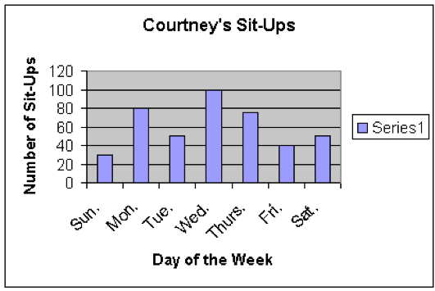
b. Data that has really big changes from year to year (or day to day...)
Ex. 1 (Year to Year)
Ex. 2 (Day to Day)
Millions ($)

Slide 9
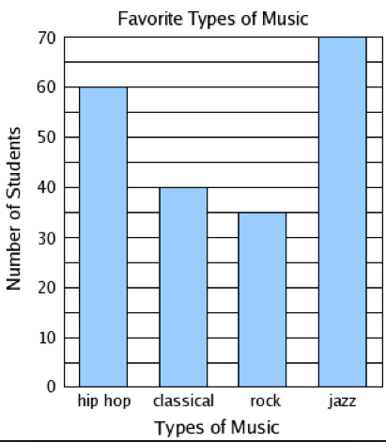
c. Comparing nominal groups (i,.e. grades, music types, colors, etc…)
Ex. “What are the Favorite Types of Music among Students?”

Slide 10
Check List to Making Bar Graphs
5 Steps
Graph Paper
y-axis
- Scaling (0 to ?)
- Determine increments
of intervals on the y-axis
Ex. By 0.5; 1.0s; 2.0s,
5.0s,10s, 20s, 100s, etc...
-Label & units
3. x-axis
- Label x-axis
- Write Nominal Groups
- Width of bars consistency
Ex. 2 to 4 Boxes in width
4. Title of Graph
5. Key (for multiple bar graphs)

Slide 11
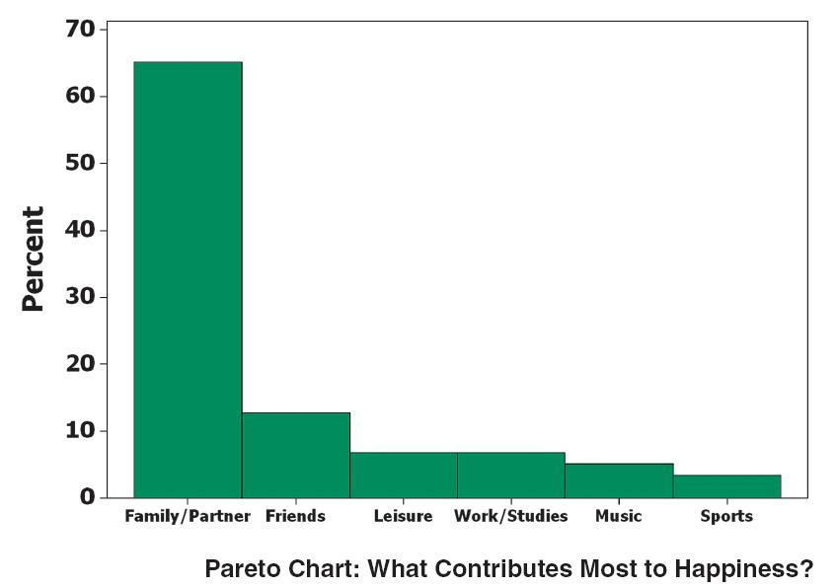
Other Types of Bar Graphs (2 Types)
Pareto Chart
-Bars arranged in descending order according to frequencies.
Ex.

Slide 12
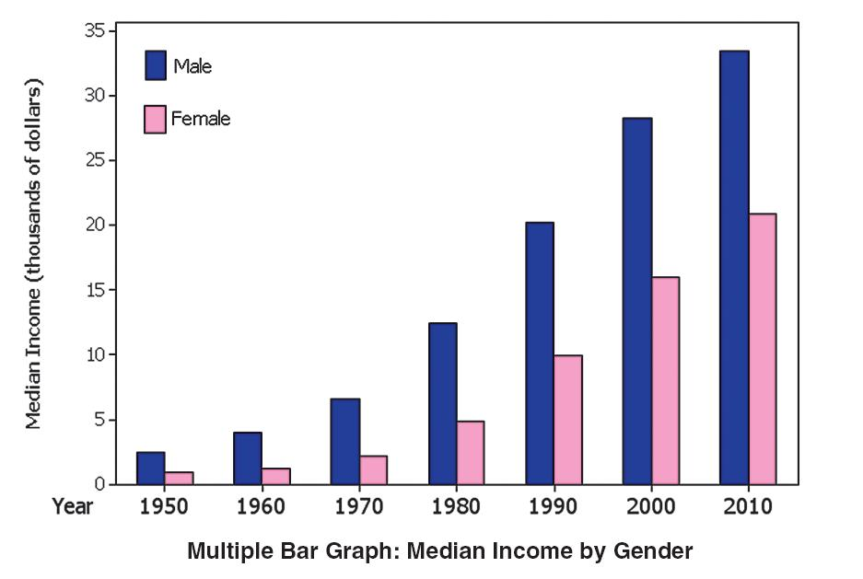
2. Multiple Bar Graph
Has two or more sets of bars
Used to compare two or more data sets.

Slide 13
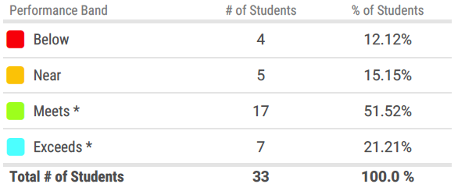
Practicing Problem
Given the data for Ms. Ng’s Stats Class, create a Bar Graph that displays Ch 1 M/C Test (in frequency; # count)

